Slide 1
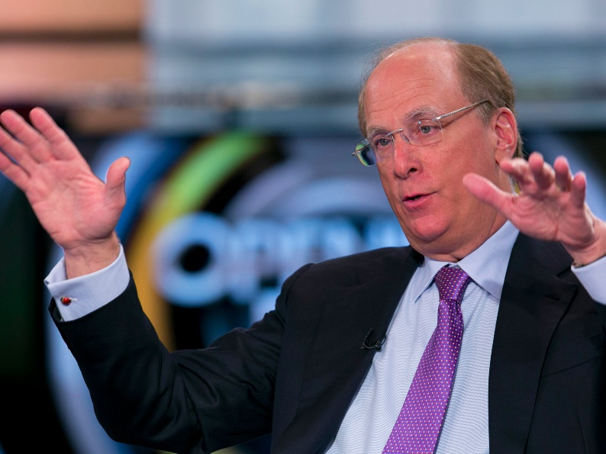
Big Voices
As an asset manager, BlackRock invests on behalf of others, and I am writing to you as an advisor and fiduciary to these clients…people in dozens of countries trying to finance long- term goals like retirement…we have a deep responsibility to institutions and individuals–who are shareholders in your company and thousands of others – to promote long-term value.
Climate change has become a defining factor in companies’ long-term prospects. …Will cities…be able to afford their infrastructure needs as climate risk reshapes the market for municipal bonds? What will happen to the 30-year mortgage – a key building block of finance – if lenders can’t estimate the impact of climate risk over such a long timeline, and if there is no viable market for flood or fire insurance in impacted areas?
Climate Risk Is Investment Risk
As a fiduciary, our responsibility is to help clients navigate this transition. This challenge
cannot be solved without a coordinated, international response from governments, aligned with the goals of the Paris Agreement…companies and investors have a meaningful role to play …. That is why BlackRock is signatory to the UN’s Principles for Responsible Investment, and we signed the Vatican’s 2019 statement advocating carbon pricing regimes, which we believe are essential to combating climate change.
BlackRock has been engaging with companies for several years on their progress towards TCFD- and SASB-aligned reporting. This year, we are asking the companies that we invest in on behalf of our clients to: (1) publish a disclosure in line with industry-specific SASB guidelines by year-end, if you have not already done so, or disclose a similar set of data in a way that is relevant to your particular business; and (2) disclose climate-related risks in line with the TCFD’s recommendations…We will use these disclosures and our engagements to ascertain whether companies are properly managing and overseeing these risks within their business and adequately planning for the future. In the absence of robust disclosures, investors, including BlackRock, will increasingly conclude that companies are not adequately managing risk.
We believe that when a company is not effectively addressing a material issue, its directors should be held accountable. Last year BlackRock voted against or withheld votes from 4,800 directors at 2,700 different companies. …
Larry Fink, BlackRock portfolio company letter, January 2020
Notes:
BlackRock's green ETF adds record cash
After announcing its newfound focus on social investing and ESG, the BlackRock iShares ESG MSCI USA ETF (ESGU) recorded its biggest-ever inflow in January, totaling $1.15 billion, Bloomberg reports.

Slide 2
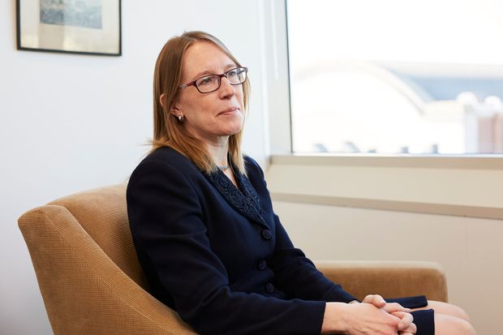
Big Voices (2)
ESG FUNDS DRAW SCRUTINY (WSJ, 12/16/19)
The Securities and Exchange Commission has sent examination letters to firms as record amounts of money flow into ESG funds. These funds broadly market themselves as trying to invest in companies that pursue strategies to address environmental, social or governance challenges, such as climate change and corporate diversity…
The SEC initiative is based out of the agency’s Los Angeles office, according to a person familiar with the matter. It has focused on advisers’ criteria for determining an investment to be socially responsible and their methodology for applying those criteria and making investments…
One letter the SEC sent earlier this year to an investment manager with ESG offerings asked for a list of the stocks it had recommended to clients, its models for judging which companies are environmentally or socially responsible, and its best- and worst-performing ESG investments, according to a copy of the letter viewed by The Wall Street Journal.
The regulator (asked) whether the adviser followed well-known policies for socially responsible investing, including UNPRI… Investment firms including BlackRock Inc. and Fidelity Investments have signed onto the U.N. framework…The SEC also homed in on proxy voting (and)…asked for proxy voting records and documents that related to how the adviser decided to vote on an ESG issue…Ms. Peirce has criticized ESG for having no enforceable or common meaning.
“While financial reporting benefits from uniform standards developed over centuries, many ESG factors rely on research that is far from settled,” she said in a speech last year to California State University Fullerton’s Center for Corporate Reporting and Governance….
Hester Peirce, SEC Examiner 2019
Notes:
SEC examiners are separate from the regulator’s enforcement division but can seek information from a broad group of firms to learn about new trends or concerns. Examiners can issue deficiency letters based on their findings that tell companies they are out of step with rules. While the letters don’t trigger fines, examiners can refer their findings to SEC enforcement attorneys for a formal investigation.

Slide 3
Standards most-referenced (n=~4000)
*
**
Source: Shearman & Sterling LLP. (2019). Corporate Governance & Executive Compensation Survey 2019.
*Sustainability Accounting Standards Board
**Task Force on Climate-related Financial Disclosures
The State of Corporate Citizenship 2020-Figure 10
Notes:
Today, a wide variety of stakeholders expect that companies communicate their corporate citizenship commitments and progress toward goals to address issues such as climate change and social inequality. This has resulted in a dramatic increase in corporate citizenship reporting. According to a recent KPMG report, 93% of the 250 largest global corporations now publish corporate citizenship reports, up from only 35% twenty years ago.* A 2019 survey from Shearman & Sterling of the 100 largest U.S. public companies found that 38% of firms are using a single standard in their corporate citizenship reporting while 52% are using multiple standards.
*Boonen, M. (2017). The KPMG Survey of Corporate Responsibility Reporting. Retrieved May 30, 2019, from https://home.kpmg/be/en/home/insights/2017/10/the-kpmg-survey-of-corporate-responsibility-reporting-2017.html.

Slide 4
Corporate Reporting Dialogue
Better Alignment Project
The Project looks to ensure that the reporting landscape supports organisations in preparing climate and broader ESG disclosures that meet the evolving information needs of capital markets and society.
The Project brings together CDP, CDSB, GRI, IIRC and SASB—and now TCFD—to drive better alignment across reporting frameworks and standards. Participants are working together to refine overlapping principles, disclosure requirements and indicators, subject to the due process considerations of each Participant’s governance procedures. The aim is to ensure coherence, consistency and comparability of disclosures.

Slide 5
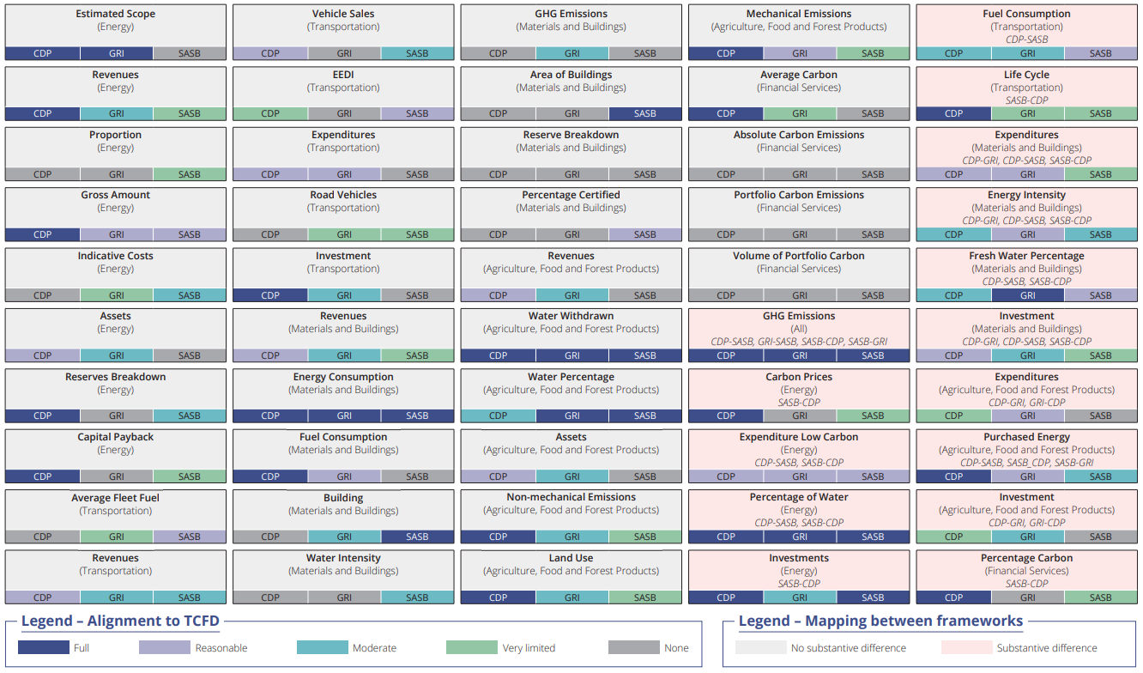
Alignment of GRI, CDP, SASB to TCFD
From GRI Reports Database – Limited Version

