Slide 2
About The State of Corporate Citizenship 2017

Slide 3
Rising inequality
Notes:
In the United States—which has one of the greatest levels of income disparity in advanced nations—the effect of inequality on social mobility is especially evident.

Slide 4
Factors that impact corporate citizenship
Notes:
Executives perceive the current climate to be conducive to the development and execution of corporate citizenship programs. The majority of executives report that every listed aspect of the corporate environment is more likely to help corporate citizenship efforts than to hinder them. As was the case in the 2014 study, executives find employees to be vital to the success of corporate citizenship efforts, with the importance of non-management employees rising above the general public for the first time.

Slide 5
Company disclosure and global goals
Notes:
To track progress toward social and environmental targets such as the United Nations’ (UN) Sustainable Development Goals (SDGs), many companies are reporting on their efforts, and participating in indices and industry groups. More than 40% of executives reported that they release sustainability reports, with nearly 69% making use of at least one framework.

Slide 7
GHG-reduction efforts increasing for global firms following the Paris Agreement
Notes:
Companies with global operations are subject to broader environmental oversight, and are understandably more likely to react to the Paris Agreement, with 56% of executive respondents in these firms reporting that they have subsequently increased their GHG-reduction efforts.

Slide 8
GHG-reduction efforts following the Paris Agreement by revenue
Notes:
The majority of executives in firms with revenues greater than $5 billion report that their companies have already increased their GHG reduction efforts in response to the Paris Agreement, while those in smaller firms (less than $1 billion) are more likely to report that their plans haven’t altered.

Slide 9
GHG-reduction targets will be incorporated into annual development plan/performance reviews*
Notes:
Executives in larger firms are more likely to report that GHG emission reduction targets will be incorporated into annual development plan/performance reviews. The majority of executive respondents in firms with $15 billion or more in revenue report that the performance of applicable employees at all levels will be evaluated by whether such targets are met.

Slide 10
GHG-reduction efforts following the Paris Agreement by industry
Notes:
The ways in which companies are working to meet the Paris Agreement vary based on industry, though the majority of executive respondents in every sector either plan to increase GHG-reduction efforts, or have done so already. More than 95% of executive respondents from utilities—a highly regulated sector that has long been under pressure to limit its environmental impacts—report that they have already increased or plan to increase GHG-reduction efforts.

Slide 11
GHG-reduction targets and annual development plan/performance reviews by industry*
Notes:
Energy executives are most likely to report that due to the Paris Agreement, GHG-reduction efforts have been incorporated into annual development plan/performance reviews.

Slide 12
Reported success in achieving business goals
Notes:
Executives who report that they integrate corporate citizenship into their overall business strategy also report that they are more successful in achieving every listed business goal. This is especially true for reducing employee turnover rate, reducing operational cost, and improving risk management. The success rates of these goals approximately doubled when corporate citizenship was integrated.

Slide 13
Executives rank the importance of business goals
Notes:
The size of the bubble indicates relative importance with larger bubbles indicating greater relative importance.

Slide 14
Corporate citizenship contribution to achieving business goals
Notes:
Companies that integrate corporate citizenship are more likely to report success with achieving business goals compared to those with a NEUTRAL attitude toward value creation of corporate citizenship, including reporting that they are nearly 2x more likely to report success with enhancing their reputation.

Slide 15
Notes:
On the Y axis, the success of those who DO employ corporate citizenship to achieve key business goals is compared to those who have a NEUTRAL attitude toward the value creation of corporate citizenship. The chart illustrates that those employing corporate citizenship achieve success in significantly higher proportions. Bubbles higher up in the chart area indicate business outcomes that are most positively affected when corporate citizenship is employed to meet key business goals. For example, those that employ corporate citizenship are 1.3X more likely to reduce operational costs and 1.7X more likely to reduce employee turnover rates.
The X axis illustrates the increased likelihood of failing to achieve business goals among those who have a NEUTRAL attitude towards the value of corporate citizenship in achieving business goals. This illustrates the proportion of those who report that they are NOT successful among those who do not employ corporate citizenship to achieve key business objectives. Bubbles further to the right indicate the business outcomes where there is the greatest opportunity-loss among those who do not perceive the business value of corporate citizenship. For example, respondents who employ corporate citizenship tactics to achieve the key business objective of enhancing reputation are nearly twice as likely to report being successful in achieving enhanced reputation objectives. Those who are neutral about corporate citizenship are more than twice as likely to report being unsuccessful in achieving enhanced reputation.

Slide 16
Business goals and corporate citizenship contribution by industry
Notes:
The areas highlighted in orange show the correlation of where corporate citizenship contributes most to the business goals most prioritized by executives.

Slide 17
Business goals and corporate citizenship contribution by industry
Notes:
The areas highlighted in orange show the correlation of where corporate citizenship contributes most to the business goals most prioritized by executives. Not surprisingly, the goals considered most important and the ways in which corporate citizenship contributes varies by industry.

Slide 18
Business goals and corporate citizenship contribution by industry
Notes:
The areas highlighted in orange show the correlation of where corporate citizenship contributes most to the business goals most prioritized by executives. Not surprisingly, the goals considered most important and the ways in which corporate citizenship contributes varies by industry.

Slide 19
Business goals and corporate citizenship contribution by industry
Notes:
The areas highlighted in orange show the correlation of where corporate citizenship contributes most to the business goals most prioritized by executives.

Slide 20
Business goals and corporate citizenship contribution by industry
Notes:
The area highlighted in orange shows the correlation of where corporate citizenship contributes most to the business goals most prioritized by executives.

Slide 21
Executives that found corporate citizenship important increased resource investment over the past three years
Notes:
Corporate citizenship dimensions are listed from greatest to least importance, as reported by executive respondents. The majority of executive respondents report that their companies have increased resource commitments for all dimensions. Environmental efforts such as sustainable use of resources and the development of environmentally friendly products received the greatest increase in investment, signaling a heightened awareness of emerging regulations related to climate change, as well as the expectations of investors and other external stakeholders.

Slide 22
The average total organizational cost of a data breach over three years (measured in millions of U.S. dollars)
Notes:
By gathering data—from their consumers, partnerships, and operations, companies are arming themselves with the information necessary to anticipate, differentiate, and innovate. While data offers companies a multitude of advantages, it also poses serious risks. Data breaches—more the half of which are the result of malicious or criminal attacks—are steadily on the rise, as are the costs associated with them. In 2016, the cost of a breach rose to $4 million per incident on average, a 29% increase since 2013. The average total organizational cost in the United States—where breaches are the most expensive—was $7.01 million.*
While damages and fines are responsible for a portion of the cost, the largest financial consequence to organizations that experience a data breach is lost business. This cost is highest for U.S. companies, which pay the most for customer turnover, increased customer acquisition activities, reputation losses, and diminished goodwill.* Corporate citizenship professionals can work to limit these impacts by partnering internally with operational and marketing teams to ensure that companies clearly explain their data collection processes, and offer ways for customers to opt in and out of them, as well as have some say in determining how any personal information is used.
*Source: Ponemon Institute. (2016) . 2016 cost of data breach study: Global analysis. Retrieved from http://www.03.ibm.com/security/data-breach/

Slide 23
Change in importance of corporate citizenship dimensions
Notes:
This figure depicts how corporate citizenship priorities change in importance over time, with arrows traveling upwards indicating an increase in importance, and arrows traveling downwards signaling decreased prioritization. As was the case in the 2014 State of Corporate Citizenship study, consumer data privacy and protection and employee safety practices remain the most prioritized dimensions of corporate citizenship, which illustrates not only the competitive opportunities presented by these factors when executed well, but also the important risks posed by them if not handled carefully. Programs to increase employee diversity and inclusion have advanced in the ranking since the last study, and are now listed as the third most prioritized dimension by 2016 executive respondents.

Slide 24
Corporate citizenship dimensions – prioritization by industry
Notes:
Within each industry, executives were asked to identify their highest and lowest corporate citizenship priorities. Issues that received majority prioritization are the deepest blue, while those that were prioritized by the fewest number of respondents are the brightest blue. In some industries, certain issues were considered of equal importance. The corporate citizenship dimensions that are prioritized by executives differ by industry and are well-aligned to the nature of their business. For example, the finance/insurance industry—a sector entirely dependent on data and trust, most highly prioritizes consumer data protection and privacy, but places less emphasis on pollution prevention practices and recycling programs, as its use of natural resources is minimal. These dimensions are more important to the biotechnology and energy sectors, which use these assets in greater amounts and create more waste in the process.

Slide 25
The top stakeholders considered when developing corporate citizenship efforts
Notes:
Executives were asked to prioritize the top five stakeholder groups they consider when developing corporate citizenship efforts. Company characteristics, including operational scope, company type, consumer type, and size (measured by revenue) affect the prioritization of stakeholder groups. For example, a private company serving business clients is most likely to consider the needs and expectations of its boards and executives, while a public B2B company prioritizes investors/shareholders above all others. Executives from smaller, domestic, public, and/or business-to-customer (B2C) firms are most likely to consider the needs and expectations of customers.

Slide 26
Top stakeholders considered when developing corporate citizenship efforts
Notes:
Within each industry, executives were asked to prioritize the top five stakeholder groups they consider when developing corporate citizenship efforts. Stakeholder groups that received majority prioritization are the deepest blue, while those that were prioritized by the fewest number of respondents are brightest blue. In some industries, certain groups were considered equally. Though customers are the most prioritized stakeholder group, employees, investors/shareholders, and boards and executives—groups that directly control or affect operations—are considered by the majority of executives across industries. Despite this attention to operations, supply chain partners do not appear as likely to receive attention from companies, with the notable exception of those operating in the machine/industrial goods and pharmaceuticals industries.

Slide 27
Corporate citizenship dimensions contributing to company’s overall success
Notes:
When considering which ESG dimensions contribute to company success the most, executive respondents returned again to their most prioritized dimensions, consumer data protection and privacy, employee safety practices, and programs to increase diversity and inclusion. Notably, while diversity and inclusion efforts weren’t considered the very top contributor to business success, it was considered a top priority by the largest majority of executives.

Slide 28
Executive perspectives on social issues
Notes:
Executives were asked whether their companies should be held responsible for each of the social issues listed in this figure. Their responses are compared to the respondents of executives in the 2014 study, as well as to the responses of corporate citizenship professionals from the Center’s 2015 Community Involvement Study. In that study, corporate citizenship professionals were asked to identify which issues their community involvement programs were working to address. As this figure illustrates, there is a divergence between which issues executives feel their companies should be held responsible for, and those community involvement programs are currently tackling. For example, the majority of companies are working to improve K-12 education. This issue, however, is prioritized by only 28% of executives. In contrast, the issue prioritized as the most important—promoting gender equality—is addressed by only 5% of companies as part of their community involvement programs.

Slide 29
Notes:
Within each industry, executives were asked which social issues they considered their companies should be held responsible for. Each line in this figure tracks a different industry response, and illustrates that while the majority of industries feels reasonably similar about many issues, there are a number of divergences, such as biotechnology, which considers its industry more responsible for STEM training than any other. Generally, executives are more likely to prioritize issues that are relevant to their business operations and make the most sensible use of their unique products and people. Executive respondents in the computers/electronics sector, for example, prioritize STEM training and education, increasing access to technology, and supporting youth programs. Meanwhile, health care/social assistance emphasizes increasing access to technology, which is becoming increasingly important for disease prevention and management and facilitating doctor-patient communication.

Slide 30
Executive views regarding issues by revenue
Notes:
This figure depicts how company size (measured by revenue) affects executives’ likelihood to consider their companies responsible for social issues. It illustrates that, while companies with less than $25 billion in revenue generally agree on their level of responsibility, there is a sharp increase for firms with revenues exceeding that level for nearly every social issue. It may be that these firms are more likely to be operationally complex—and thus likely to have more diverse impacts—or it may be that the high-profile nature of such large firms makes them more susceptible to the reputational consequences of corporate citizenship issues.

Slide 31
Consumer data protection and privacy contributes to business success
Notes:
This figure depicts the levels of success in achieving business goals that companies achieve when they invest in consumer data protection and privacy at different duration levels. When companies engage in consumer data protection and privacy efforts for less than one year, 66% report that they are effective in retaining customers. They are slightly more successful in achieving this goal when they invest in consumer data protection and privacy for one to four years, yet achieve the highest rates of success (82%) with investment duration of four years or more.

Slide 32
Diversity and inclusion contributes to business success
Notes:
This figure depicts the levels of success in achieving business goals that companies achieve when they invest in diversity and inclusion at different duration levels. When companies engage in diversity and inclusion efforts for less than one year, slightly more than one-half are successful in reducing their employee turnover rate. They are more successful in achieving this goal when they invest in diversity and inclusion for one to four years—64% of companies—yet achieve the highest rates of success (71%) with investment duration of four years or more.

Slide 33
Environmentally friendly products contributes to business success
Notes:
This figure depicts the levels of success in achieving business goals that companies achieve when they invest in developing environmentally friendly products at different duration levels. When companies invest in developing environmentally friendly products for less than one year, 59% of companies are successful in enhancing their reputation. They are more successful in achieving this goal when they invest in developing environmentally friendly products for one to four years—70% of companies—yet achieve the highest rates of success (82%) with investment duration of four years or more.

Slide 34
Community economic development contributes to business success
Notes:
This figure depicts the levels of success in achieving business goals that companies achieve when they invest in community economic development at different duration levels. When companies invest in community economic development for less than one year, 61% of companies are successful in improving their ability to recruit employees. They are more successful in achieving this goal when they invest in community economic development for one to four years—68% of companies—yet achieve the highest rates of success (77%) with investment duration of four years or more.

Slide 35
Reducing costs by investing in health
Notes:
Health care costs continue to be a major concern for both companies and their employees. Insurance premiums are rising every year, with family coverage up by 20% since 2011.* Contributions to insurance aren’t the only health-related expense for companies, however. Productivity losses related to personal and family health problems cost U.S. employers more than $1,600 per employee per year, or more than $225 billion annually.**
To combat these costs, many companies are investing in employee health through wellness programs. More than 80% of large firms (200 or more workers) and 46% of small firms offer a program in at least one of the following areas: smoking cessation, weight management, and behavioral or lifestyle coaching.* The majority of larger firms also offer the opportunity to complete health risk assessments or biometric screenings. Research finds that every dollar spent on wellness programs results in medical costs falling by approximately $3.27, and absenteeism costs falling by approximately $2.73.***
*SOURCE: The Kaiser Family Foundation and Health Research & Educational Trust. (2016). 2016 Employer health benefits survey. Retrieved from http://kff.org/health-costs/report/2016-employer-health-benefits-survey/
**SOURCE: CDC. (2015). CDC At a glance 2015. Workplace health promotion: Using the workplace to improve the nation’s health. CDC Publishing
***SOURCE: Baicker, K., Cutler, D., & Song, Z. (2010). Workplace wellness programs can generate savings. Health affairs, 29(2), 304-311.

Slide 36
Anticipated change in importance of dimensions to corporate citizenship success
Notes:
This figure depicts how individual dimensions have contributed to corporate citizenship success over time, and how those dimensions are expected to be prioritized in the future. Arrows traveling upward indicate an increase in importance, and arrows traveling downwards signal decreased prioritization. Consistent with the 2014 study, executive respondents are increasingly focused on environmental issues, with sustainability, environmental protection, and the development of environmentally friendly products all advancing in importance by 2019.

Slide 37
Resources will increase for corporate citizenship dimensions over next 3 years
Notes:
The majority of executive respondents expect resources to increase for every listed corporate citizenship dimension over the next three years, at even greater numbers than in the 2014 study. Understandably, the most significant gains are anticipated in the dimensions that are currently most prioritized, though sustainable use of resources is expected to receive slightly more investment than employee safety practices, illustrating an awareness of future ESG expectations.

Slide 38
Profile of companies surveyed
Notes:
Nearly one-half of companies have at least 5,000 employees. In 2016, close to 60% of companies have at least $5 billion in revenue. Companies have strong financial performance, with 86% reporting an increase in revenue over the previous year. Survey opened to private nonprofit companies in 2016. One-half of the companies are both B2B and B2C. Two-thirds of companies have global operations.

Slide 39
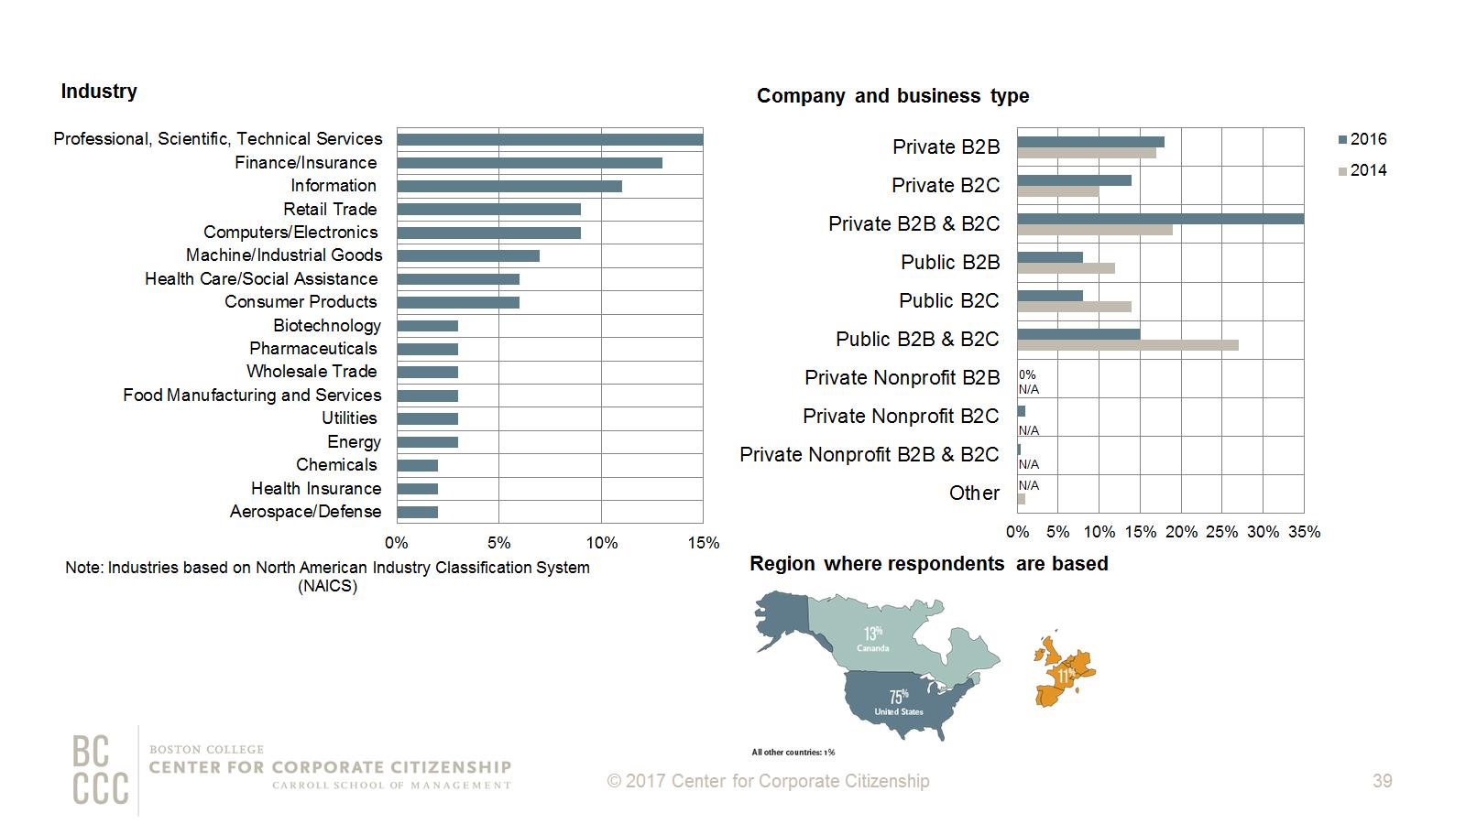
Notes:
In 2016, professional, scientific, and technical services is the largest industry. Also in the current study, 35% of companies are private and both B2B and B2C. The majority of executive respondents are based in the U.S.

Slide 40
About The State of Corporate Citizenship 2017 Report

Slide 41
About the Center for Corporate Citizenship

