Slide 3
Top social issues addressed through community involvement efforts
Notes:
More than 80% of utility companies include community economic development and STEM training and education among the top five social issues addressed through their community involvement efforts, both issues that are core to their business. STEM training and education is also the top three issue addressed for firms across industries.

Slide 4
Company reports having a foundation or is in the process of setting one up
Notes:
More than 55% of utility companies have a foundation or are in the process of setting one up. Overall, the percentage of companies with a foundation has declined from 53% in 2011 to one-half in 2015 and now down to 45% in the current study.

Slide 5
Community involvement contribution to business goals†
Notes:
Consistent with the total sample, all of the utility companies report that community involvement contributes to enhanced reputation and improved ability to recruit employees. More than 90% of utility companies report that community involvement contributes to reducing risk, compared to 64% of companies across industries.

Slide 6
Community involvement contribution to business goals by industry†
Notes:
Within each industry, corporate citizenship professionals were asked to identify their highest and lowest business goals. Business goals that received majority prioritization are maroon, while those that were prioritized in the middle are deep blue and by the fewest number of respondents are lightest blue. Companies across industries, including utility, recognize the role of community involvement in enhancing reputation and employee recruitment.

Slide 7
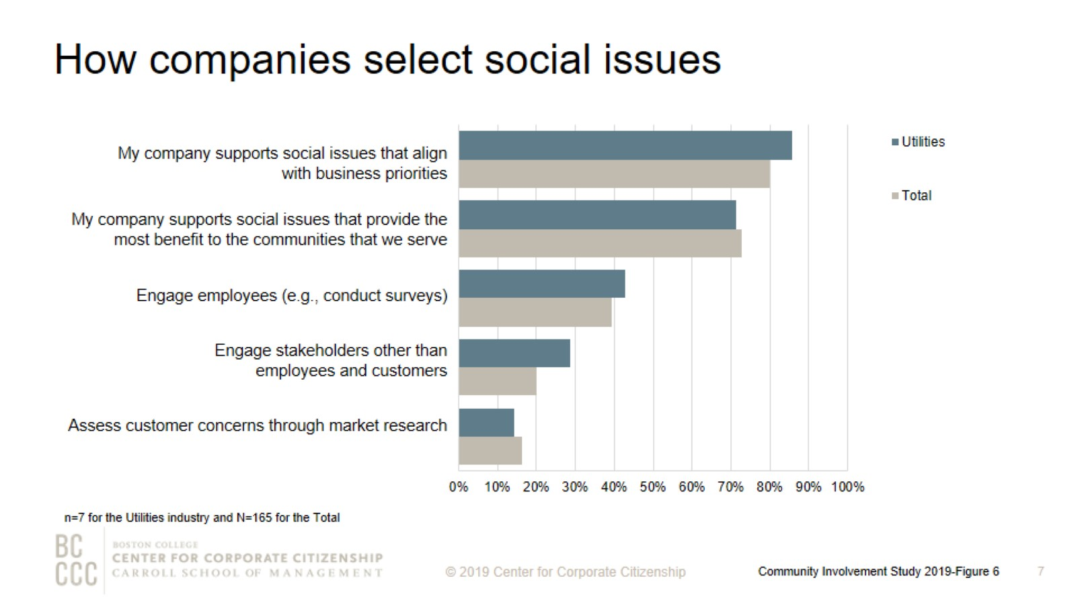
How companies select social issues
Notes:
As companies work to align community involvement efforts with their business strategies, many are reconsidering how they select the social issues to address. The most strategic companies select social issues that are important to their competitive operating environment or that they are uniquely positioned to address with their particularly differentiated capabilities and resources. Consistent with companies across industries, the majority of utility companies are supporting social issues that align with business priorities and provide the most benefit to their operating communities.

Slide 8
Top social issues addressed through community involvement efforts
Notes:
Utility companies are more likely than companies across industries to prioritize environmental sustainability and youth programs.

Slide 9
Percentage of companies that rank a social issue within their top 5
Notes:
The issues that companies select to address have some commonality within industries and reflect the unique capabilities and resources—from products and materials to expertise—that each company can deploy to address them. The heatmap illustrates the ways companies in different sectors are prioritizing issues. Utility companies, in addition to information technology and materials/industrial companies, are all likely to highly prioritize STEM education, which arms their future workforces with the skills needed to keep their operations running smoothly.

Slide 10
Giving directly from company
Notes:
How to read this chart
The orange line and right y-axis represent how the distributions accumulate to make 100% (the industry sub-sample). Companies represented by bars to the right of the red dot perform above the median.
Cash giving direct from the company is one of the three types of total giving to 501(c)(3) organizations or public schools, or the international equivalent of a 501(c)(3) organization. One-half of utility companies gave $1,000,000 or less for the most recently ended fiscal year. All of the companies that gave more than $5,000,000 have an annual revenue of at least $5 billion.

Slide 11
One-time gifts/grants - Typical amount
Notes:
How to read this chart
The orange line and right y-axis represent how the distributions accumulate to make 100% (the industry sub-sample). Companies represented by bars to the right of the red dot perform above the median.
Companies either give one-time donations or multi-year grants. More than 85% of utility companies offer a typical one-time gift or grant of $5,000 or less.

Slide 12
Corporate giving to nonprofits based outside of headquarter countries
Notes:
Utility companies give to nonprofits based within their headquarters country only.

Slide 13
Method

Slide 14
Demographics

Slide 15
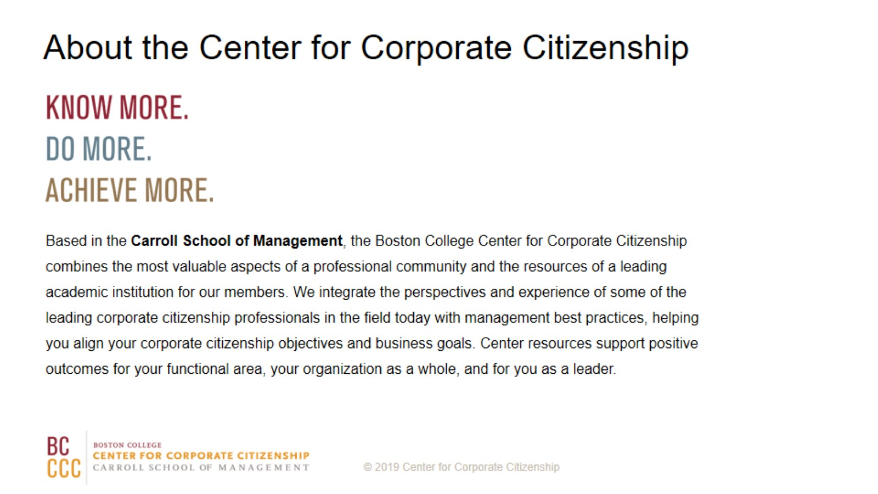
About the Center for Corporate Citizenship

