Slide 3
Top social issues addressed through community involvement efforts
Notes:
Professional, educational, and consumer services companies include three educational areas among their top five social issues addressed through community involvement efforts. Companies in this industry are most likely to address K-12 education both within their headquarters country and globally.

Slide 4
Company reports having a foundation or is in the process of setting one up
Notes:
Approximately 45% of professional, educational, and consumer services companies and firms across industries have a foundation or are in the process of setting one up. Overall, the percentage of companies with a foundation has declined from 53% in 2011 to one-half in 2015 and now down to 45% in the current study.

Slide 5
Community involvement contribution to business goals†
Notes:
Consistent with the total sample, nearly all of the professional, educational, and consumer services companies report that community involvement contributes to enhanced reputation and improved ability to recruit employees. Professional, educational, and consumer services companies are less likely than the total sample to report that community involvement contributes to the other listed business goals, with the exception of reducing employee turnover rate.

Slide 6
Community involvement contribution to business goals by industry†
Notes:
Within each industry, corporate citizenship professionals were asked to identify their highest and lowest business goals. Business goals that received majority prioritization are maroon, while those that were prioritized in the middle are deep blue and by the fewest number of respondents are lightest blue. Companies across industries, including professional, educational, and consumer services, recognize the role of community involvement in enhancing reputation and employee recruitment.

Slide 7
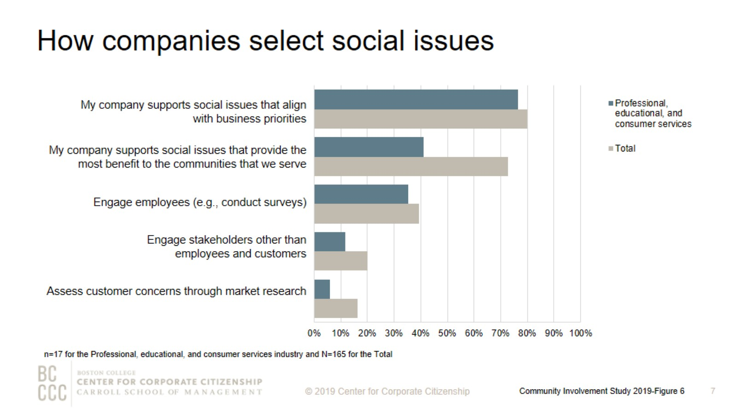
How companies select social issues
Notes:
As companies work to align community involvement efforts with their business strategies, many are reconsidering how they select the social issues to address. The most strategic companies select social issues that are important to their competitive operating environment or that they are uniquely positioned to address with their particularly differentiated capabilities and resources. Consistent with the total sample, more than 75% of professional, educational, and consumer services companies support social issues that align with business priorities.

Slide 8
Top social issues addressed through community involvement efforts
Notes:
Companies within the professional, educational, and consumer services industry are four times more likely to include STEM training and education among the top five issues addressed within headquarters country than globally. Gender equality is much more likely to be addressed in global community involvement efforts. Professional, educational, and consumer services companies are three times as likely to include this issue among the top three addressed outside of their headquarters country compared to within headquarters.

Slide 9
Percentage of companies that rank a social issue within their top 5
Notes:
The issues that companies select to address have some commonality within industries and reflect the unique capabilities and resources—from products and materials to expertise—that each company can deploy to address them. The heatmap illustrates the ways companies in different sectors are prioritizing issues. Consistent with some of the other industries, K-12 education is highly prioritized within the professional, educational, and consumer services industry. Diversity and inclusion is another top priority for the industry.

Slide 10
Community involvement professionals consistently rank employee engagement as a top benefit of volunteer programs
Notes:
All of the professional, educational, and consumer services companies report that their company offers an employee volunteer program. Employee engagement continues to be a strong motivator for companies that implement employee volunteer programs. More than 85% of professional, educational, and consumer services companies ranked improved employee engagement as one of the top three benefits of volunteer programs. Reputation is another strong motivator for professional, educational, and consumer services companies and for firms across industries. One-third of professional, educational, and consumer services companies reported that establishing a positive brand within operating communities is the top benefit of their volunteer program.

Slide 11
Volunteer program participation rates
Notes:
Fifty-five percent of professional, educational, and consumer services companies report employee volunteering participation rates of 30% or less.

Slide 12
Ways that companies track employee volunteer participation
Notes:
More companies are now tracking their employee volunteering participation rates. More than 55% of professional, educational, and consumer services companies track participation both in the employee volunteer program and outside of it.

Slide 13
Annual operating budget for employee volunteer programs for prior fiscal year
Notes:
As employee volunteer programs expand and serve business needs more directly, a majority of companies have a dedicated budget just for employee volunteer programs. More than 25% of professional, educational, and consumer services companies have an operating budget of $500,000 or more, compared to 13% of firms across industries that have a budget of at least $500,000.

Slide 14
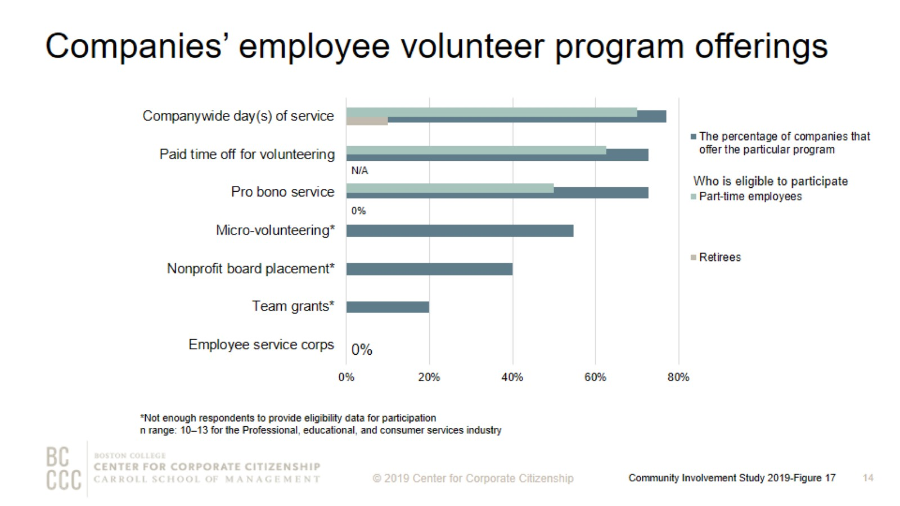
Companies’ employee volunteer program offerings
Notes:
More than 70% of professional, educational, and consumer services companies offer companywide day(s) of service, paid time for volunteering, and pro bono service. The majority of professional, educational, and consumer services companies offer part-time employees the opportunity to participate in companywide day(s) of service and paid time off for volunteering.

Slide 15
Remote employees’ eligibility for volunteer program offerings
Notes:
The majority of professional, educational, and consumer services companies offer remote employees based in headquarters region the opportunity to participate in companywide day(s) of service, paid time off for volunteering, and pro bono service.

Slide 16
Workplace giving programs
Notes:
In order to meet to a wide variety of employee interests, companies offer an assortment of options for employees to give. Two-thirds of professional, educational, and consumer services firms that have a workplace giving program offer a disaster relief program. The majority of professional, educational, and consumer services firms also offer a giving campaign and gifts for any purpose. Nearly 70% of professional, educational, and consumer services companies that offer workplace giving programs provide a match for at least one purpose.

Slide 17
Percent of companies offering giving programs, by employee type
Notes:
Professional, educational, and consumer services companies are close to twice as likely than the total sample to offer international employees the opportunity to participate in giving programs.

Slide 18
Giving directly from company
Notes:
How to read this chart
The orange line and right y-axis represent how the distributions accumulate to make 100% (the industry sub-sample). Companies represented by bars to the right of the red dot perform above the median.
Cash giving direct from the company is one of the three types of total giving to 501(c)(3) organizations or public schools, or the international equivalent of a 501(c)(3) organization. The majority of professional, educational, and consumer services companies gave $2,500,000 or less for the most recently ended fiscal year. Three of the four professional, educational, and consumer services companies that gave more than $2,500,000 have an annual revenue of at least $5 billion.

Slide 19
Giving directly through foundation
Notes:
How to read this chart
The orange line and right y-axis represent how the distributions accumulate to make 100% (the industry sub-sample). Companies represented by bars to the right of the red dot perform above the median.
Cash giving through the company’s foundation is one of the three types of total giving to 501(c)(3) organizations or public schools, or the international equivalent of a 501(c)(3) organization. The majority of professional, educational, and consumer services companies gave less than $2,500,000 for the most recently ended fiscal year. The three professional, educational, and consumer services companies that gave $2,500,000 or more through the foundation have an annual revenue of $1 billion or more.

Slide 20
One-time gifts/grants - Typical amount
Notes:
How to read this chart
The orange line and right y-axis represent how the distributions accumulate to make 100% (the industry sub-sample). Companies represented by bars to the right of the red dot perform above the median.
Companies either give one-time donations or multi-year grants. Nearly 60% of professional, educational, and consumer services companies offer a typical one-time gift or grant of $5,000 or less.

Slide 21
Annual operating budget for corporate giving
Notes:
Nearly all companies have a discrete operating budget (exclusive of the gifts and grants budget) allocated to managing giving efforts. Corporate giving operating budgets for professional, educational, and consumer services companies are generally smaller than the total sample in this study.

Slide 22
Corporate giving to nonprofits based outside of headquarter countries
Notes:
More than one-half of professional, educational, and consumer services companies give to nonprofits globally.

Slide 23
Giving split between international and domestic nonprofits for global givers
Notes:
Companies are more likely to give internationally than in previous studies. Professional, educational, and consumer services companies on average give 12% to international nonprofits and 88% to domestic nonprofits.

Slide 24
Using vendors to vet international nonprofit organizations
Notes:
Engaging in corporate giving internationally can be a complex task. While the benefits of global giving are many (expand markets, engage international employees, support suppliers), it can be difficult to navigate the regulations—and even cultural expectations—of different recipient countries. That’s why many companies are turning to vendors to help them manage global giving. In this study, more than one-fifth of information technology companies use a vendor to vet international nonprofit organizations. One-third of information technology companies engage a vendor to actually execute the global giving, which is slightly higher than the total sample.

Slide 25
Measurement of community involvement programs
Notes:
Measurement level definitions
Inputs: resources needed to support a program (e.g., time spent, budget, materials, and marketing).
Outputs: units of goods or services that benefit a particular target audience (e.g., number of meals delivered or hours spent mentoring youth after school).
Outcomes: results, or effects on target audience; typically single-system and shorter term (e.g., improved child health, better school performance, or decrease in youth involved in gang-related activity).
Impact: long term, multi-system results (e.g., intergenerational gains in income equality).
The majority of professional, educational, and consumer services companies that measure at least one level of their employee volunteer programs (64%), employee giving (70%), and/or corporate giving (54%) report that they measure the outputs of their programs.

Slide 26
Method

Slide 27
Demographics

Slide 28
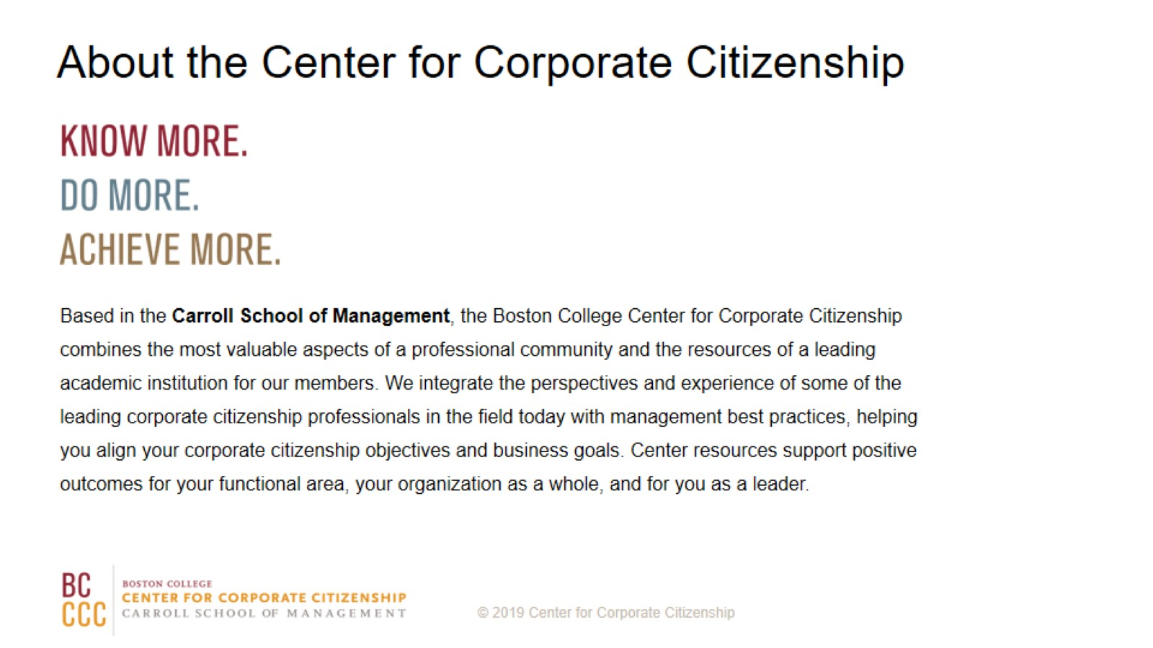
About the Center for Corporate Citizenship

