Slide 3
Companies find a positive correlation between volunteer participation and engagement scores
Notes:
Nearly three-quarters of companies in the materials/industrials industry measure the relationship between employee volunteer participation and employee engagement scores and 89% of those companies found a positive correlation.

Slide 4
Top social issues addressed through community involvement efforts
Notes:
Consistent with firms in other industries, materials/industrial companies are most likely to prioritize social issues that are core to their business – STEM training and education and environmental sustainability.

Slide 5
Company reports having a foundation or is in the process of setting one up
Notes:
Nearly 65% of materials/industrial companies have a foundation that administers some or all of their corporate giving or are in the process of setting one up. This is higher than the total sample, where 45% of companies have a foundation in place or are currently setting one up. Overall, the percentage of companies with a foundation has declined from 53% in 2011 to one-half in 2015 and now down to 45% in the current study.

Slide 6
Community involvement contribution to business goals†
Notes:
Materials/industrial companies are more likely than the total sample to report that community involvement contributes to such business goals as improving risk management, reducing waste in business operations, and securing a sustainable supply chain.

Slide 7
Community involvement contribution to business goals by industry†
Notes:
Within each industry, corporate citizenship professionals were asked to identify their highest and lowest business goals. Business goals that received majority prioritization are maroon, while those that were prioritized in the middle are deep blue and by the fewest number of respondents are lightest blue. Companies across industries, including materials/industrials, recognize the role of community involvement in enhancing reputation and employee recruitment.

Slide 8
How companies select social issues
Notes:
As companies work to align community involvement efforts with their business strategies, many are reconsidering how they select the social issues to address. The most strategic companies select social issues that are important to their competitive operating environment or that they are uniquely positioned to address with their particularly differentiated capabilities and resources. In this study, 82% of materials/industrial companies report that they support social issues that align with business priorities. Nearly 60% of companies within the materials/industrials industry engage their employees in the selection of social issues, compared to 39% of the total sample.

Slide 9
Top social issues addressed through community involvement efforts
Notes:
Companies within the materials/industrials industry are more likely to address STEM training and education through their community involvement programs in their headquarters country than in countries outside of where they are based, but it is still a top priority as 50% include this issue among the top five. Materials/industrial companies are most likely to address environmental sustainability and K-12 education globally.

Slide 10
Percentage of companies that rank a social issue within their top 5
Notes:
The issues that companies select to address have some commonality within industries and reflect the unique capabilities and resources—from products and materials to expertise—that each company can deploy to address them. The heatmap illustrates the ways companies in different sectors are prioritizing issues. Materials/industrial, information technology, and utility companies are all likely to highly prioritize STEM education, which arms their future workforces with the skills needed to keep their operations running smoothly.

Slide 11
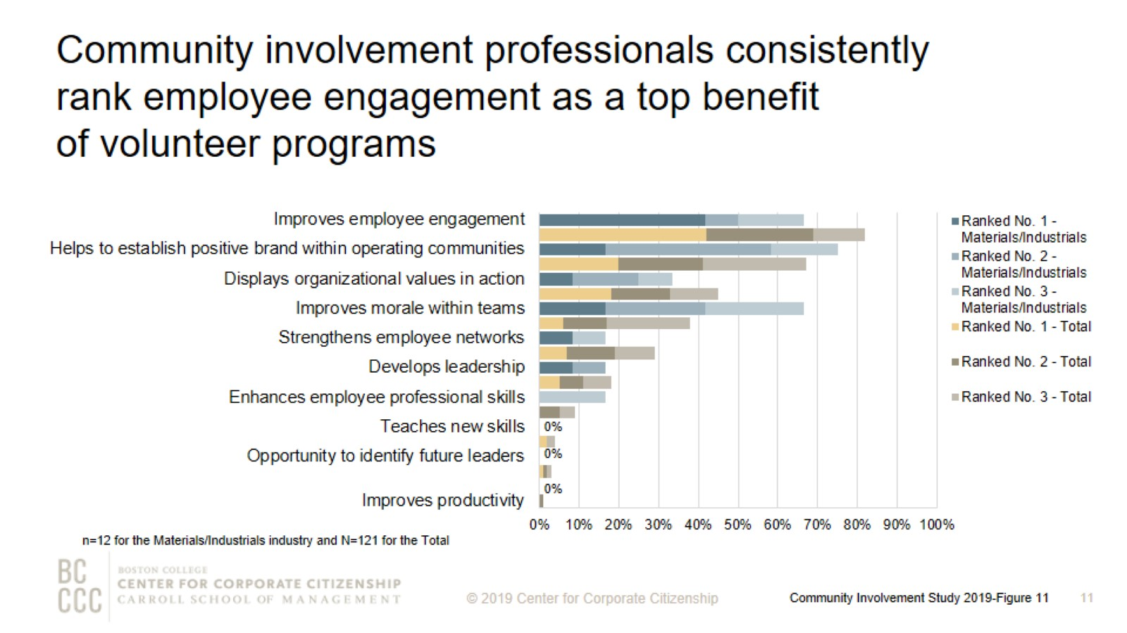
Community involvement professionals consistently rank employee engagement as a top benefit of volunteer programs
Notes:
Employee engagement continues to be a strong motivator for companies that implement employee volunteer programs. More than 40% of materials/industrial companies ranked improved employee engagement as the top benefit of volunteer programs. Three-quarters of materials/industrial companies include helps to establish positive brand within operating communities among their top three benefits.

Slide 12
Volunteer program participation rates
Notes:
More than one-half of materials/industrial companies report employee volunteering participation rates of less than 30%.

Slide 13
Ways that companies track employee volunteer participation
Notes:
More companies are now tracking their employee volunteering participation rates. Materials/industrial companies are more likely than the total sample to track participation in the employee volunteer program only rather than tracking any form of volunteering.

Slide 14
Annual operating budget for employee volunteer programs for prior fiscal year
Notes:
Eighty percent of materials/industrial companies report that their firm offers an employee volunteer program or are currently developing one. As programs expand and serve business needs more directly, a majority of companies have a dedicated budget just for employee volunteer programs. Three-quarters of materials/industrial companies are spending at least $100,000 per year on volunteer programs.

Slide 15
Companies’ employee volunteer program offerings
Notes:
The majority of materials/industrial companies offer nonprofit board placement programs and companywide day(s) of service, which is also the case for the total sample. More than 60% of materials/industrial companies offer part-time employees the opportunity to participate in companywide day(s) of service, and 38% provide retirees the option to participate. Three-quarters of companies within the materials/industrials industry provide remote employees based in the headquarters country and outside of it the opportunity to participate in the companywide day(s) of service.

Slide 16
Workplace giving programs
Notes:
In order to meet to a wide variety of employee interests, companies offer an assortment of options for employees to give. Nearly all materials/industrial firms that offer a workplace giving program offer disaster relief giving programs and more than 80% have a dedicated campaign for workplace giving. Approximately three-quarters of companies within the materials/industrials industry offer a match for their disaster relief programs. More than 80% of materials/industrial companies that offer workplace giving programs provide a match for at least one purpose. Of the companies that offer gifts for any purpose, nearly 90% of them provide a match.

Slide 17
Percent of companies offering giving programs, by employee type
Notes:
Materials/industrial companies are twice as likely as the total sample to offer board members the opportunity to participate in giving programs.

Slide 18
Giving directly from company
Notes:
How to read this chart
The orange line and right y-axis represent how the distributions accumulate to make 100% (the industry sub-sample). Companies represented by bars to the right of the red dot perform above the median.
Cash giving direct from the company is one of the three types of total giving to 501(c)(3) organizations or public schools, or the international equivalent of a 501(c)(3) organization. The majority of materials/industrial companies gave $5,000,000 or less for the most recently ended fiscal year. All of the material/industrial companies that gave more than $5,000,000 have an annual revenue of at least $5 billion.

Slide 19
Giving directly through foundation
Notes:
How to read this chart
The orange line and right y-axis represent how the distributions accumulate to make 100% (the industry sub-sample). Companies represented by bars to the right of the red dot perform above the median.
Cash giving through the company’s foundation is one of the three types of total giving to 501(c)(3) organizations or public schools, or the international equivalent of a 501(c)(3) organization. One-half of materials/industrial companies gave $10,000,000 or less for the most recently ended fiscal year, which is higher than cash giving. Consistent with the total sample, materials/industrial companies are more likely to give higher amounts through their foundation than cash giving directly from the company. All of the companies that gave more than $10,000,000 through the foundation have an annual revenue of at least $5 billion.

Slide 20
Noncash contributions*
Notes:
How to read this chart
The orange line and right y-axis represent how the distributions accumulate to make 100% (the industry sub-sample). Companies represented by bars to the right of the red dot perform above the median.
Noncash contributions assessed at fair market value (FMV) (e.g., merchandise, pro bono service, and supplies) is one of the three types of total giving to 501(c)(3) organizations or public schools, or the international equivalent of a 501(c)(3) organization. Many companies offer noncash contributions in addition to direct and foundation giving. The majority of materials/industrial companies—five of the nine firms in this study—gave $500,000 or less in noncash contributions for the most recently ended fiscal year.

Slide 21
One-time gifts/grants - Typical amount
Notes:
How to read this chart
The orange line and right y-axis represent how the distributions accumulate to make 100% (the industry sub-sample). Companies represented by bars to the right of the red dot perform above the median.
Companies either give one-time donations or multi-year grants. More than 60% of materials/industrial companies are likely to offer a typical one-time gift or grant of $10,000 or less.

Slide 22
Multi-year gifts/grants - Minimum amount
Notes:
How to read this chart
The orange line and right y-axis represent how the distributions accumulate to make 100% (the industry sub-sample). Companies represented by bars to the right of the red dot perform above the median.
Sixty percent of materials/industrial companies offer $10,000 or less for their minimum multi-year gift/grant amount.

Slide 23
Multi-year gifts/grants - Typical amount
Notes:
How to read this chart
The orange line and right y-axis represent how the distributions accumulate to make 100% (the industry sub-sample). Companies represented by bars to the right of the red dot perform above the median.
More than 60% of materials/industrial companies donate $50,000 or less as a typical multi-year grant.

Slide 24
Multi-year gifts/grants - Maximum amount
Notes:
How to read this chart
The orange line and right y-axis represent how the distributions accumulate to make 100% (the industry sub-sample). Companies represented by bars to the right of the red dot perform above the median.
The maximum sized multi-year gift/grant offered by the majority of materials/industrial companies is $500,000 or less.

Slide 25
Annual operating budget for corporate giving
Notes:
Nearly all companies have a discrete operating budget (exclusive of the gifts and grants budget) allocated to managing giving efforts. Three of the eight (38%) materials/industrial companies have an annual operating budget for corporate giving of at least $1,000,000.

Slide 26
Structure of corporate foundations
Notes:
Consistent with the total sample, the most common type of foundation is primarily pass-through for materials/industrial companies, which means at least 75% of the foundation’s gifts/grants budget is provided annually by the company.

Slide 27
Corporate giving to nonprofits based outside of headquarter countries
Notes:
Nearly 65% of materials/industrial companies give to nonprofits based outside of their headquarter countries, compared to 47% of firms across industries that give globally.

Slide 28
Giving split between international and domestic nonprofits for global givers
Notes:
Companies are more likely to give internationally than in previous studies. Materials/industrial companies give a higher proportion on average to international nonprofits compared to the total sample, 33% versus 20%, respectively.

Slide 29
Using vendors to vet international nonprofit organizations
Notes:
Engaging in corporate giving internationally can be a complex task. While the benefits of global giving are many (expand markets, engage international employees, support suppliers), it can be difficult to navigate the regulations—and even cultural expectations—of different recipient countries. That’s why many companies are turning to vendors to help them manage global giving. In this study, nearly one-third of materials/industrial companies use a vendor to vet international nonprofit organizations. Materials/industrial companies are less likely to engage a vendor to actually execute the global giving (15%), which is lower than the total sample (29%).

Slide 30
Measurement of community involvement programs
Notes:
Measurement level definitions
Inputs: resources needed to support a program (e.g., time spent, budget, materials, and marketing).
Outputs: units of goods or services that benefit a particular target audience (e.g., number of meals delivered or hours spent mentoring youth after school).
Outcomes: results, or effects on target audience; typically single-system and shorter term (e.g., improved child health, better school performance, or decrease in youth involved in gang-related activity).
Impact: long term, multi-system results (e.g., intergenerational gains in income equality).
The majority of materials/industrial companies that measure at least one level of their employee volunteer programs (83%), employee giving (53%), and/or corporate giving (67%) report that they measure both inputs and outputs of their programs.

Slide 31
Method

Slide 32
Demographics

Slide 33
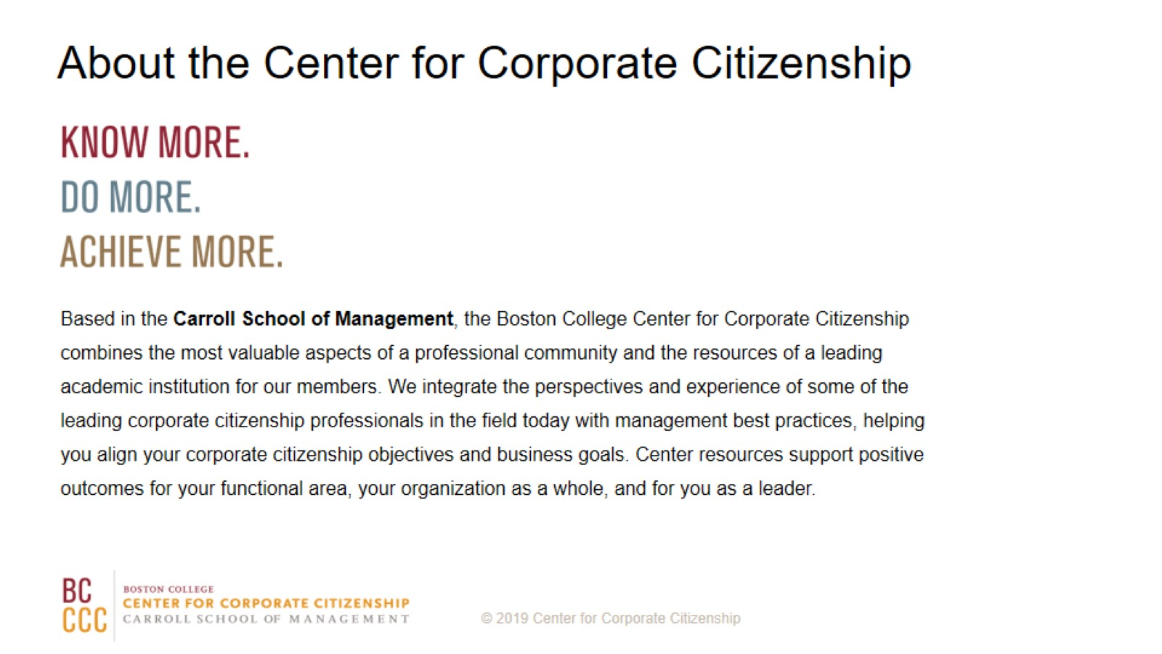
About the Center for Corporate Citizenship

