Slide 3
Companies find a positive correlation between volunteer participation and engagement scores
Notes:
Nearly 60% of companies in the insurance industry measure the relationship between employee volunteer participation and employee engagement scores and 88% of those companies found a positive correlation.

Slide 4
Top social issues addressed through community involvement efforts
Notes:
Three-quarters of insurance companies include health and wellness among its top three social issues addressed through its community involvement efforts within its headquarters country, which is a much higher percentage than companies across industries (35%).

Slide 5
Company reports having a foundation or is in the process of setting one up
Notes:
Insurance companies are more likely than companies in other industries to have a foundation or are in the process of setting one up. Overall, the percentage of companies with a foundation has declined from 53% in 2011 to one-half in 2015 and now down to 45% in the current study.

Slide 6
Community involvement contribution to business goals†
Notes:
Consistent with the total sample, all of the insurance companies report that community involvement contributes to enhanced reputation and improved ability to recruit employees. Insurance companies are more likely than the total sample to report that community involvement contributes to improving access to new markets, 81% compared to 68%, respectively.

Slide 7
Community involvement contribution to business goals by industry†
Notes:
Within each industry, corporate citizenship professionals were asked to identify their highest and lowest business goals. Business goals that received majority prioritization are maroon, while those that were prioritized in the middle are deep blue and by the fewest number of respondents are lightest blue. Companies across industries, including insurance, recognize the role of community involvement in enhancing reputation and employee recruitment.

Slide 8
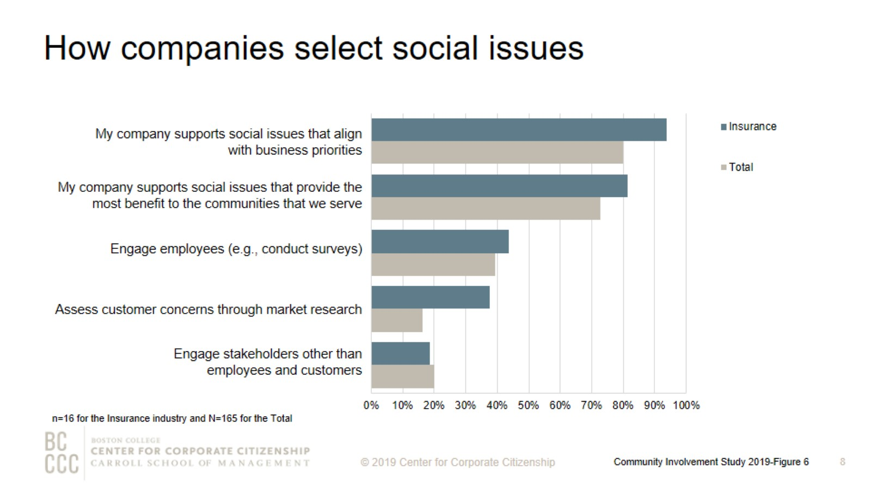
How companies select social issues
Notes:
As companies work to align community involvement efforts with their business strategies, many are reconsidering how they select the social issues to address. The most strategic companies select social issues that are important to their competitive operating environment or that they are uniquely positioned to address with their particularly differentiated capabilities and resources. Consistent with the total sample, the majority of insurance companies support social issues that align with business priorities and provide the most benefit to the communities they serve. Insurance companies are more than twice as likely as companies across industries to assess customer concerns through market research.

Slide 9
Top social issues addressed through community involvement efforts
Notes:
Insurance companies are more likely to prioritize disaster preparedness, response, and/or recovery compared to companies across industries. One-half of insurance companies include this social issue in the top five issues addressed through community involvement efforts, compared to 31% of the total sample.

Slide 10
Percentage of companies that rank a social issue within their top 5
Notes:
The issues that companies select to address have some commonality within industries and reflect the unique capabilities and resources—from products and materials to expertise—that each company can deploy to address them. The heatmap illustrates the ways companies in different sectors are prioritizing issues. Insurance companies, which includes life and health insurers, and health care companies are most likely to prioritize health and wellness.

Slide 11
Community involvement professionals consistently rank employee engagement as a top benefit of volunteer programs
Notes:
Nearly 90% of insurance companies report that their company offers an employee volunteer program. Employee engagement continues to be a strong motivator for companies that implement employee volunteer programs. One-third of insurance companies ranked improved employee engagement as the top benefit of volunteer programs. Reputation is another strong motivator for insurance companies and for firms across industries. More than 85% of insurance companies reported that establishing a positive brand within operating communities is among the top three benefits of their volunteer programs.

Slide 12
Volunteer program participation rates
Notes:
Forty-five percent of insurance companies report employee volunteering participation rates of 30% or less.

Slide 13
Ways that companies track employee volunteer participation
Notes:
More companies are now tracking their employee volunteering participation rates. Two-thirds of insurance companies track participation both in the employee volunteer program and outside of it.

Slide 14
Companies’ employee volunteer program offerings
Notes:
The majority of insurance companies offer paid time for volunteering, nonprofit board placement, pro bono service, companywide day(s) of service, and team grants. One-half of insurance companies offer part-time employees the opportunity to participate in pro bono service and companywide day(s) of service. Retirees are not eligible to participate in nonprofit board placement, pro bono service, or companywide day(s) of service.

Slide 15
Remote employees’ eligibility for volunteer program offerings
Notes:
The majority of insurance companies offer remote employees based in headquarters region the opportunity to participate in paid time off for volunteering, pro bono service, and companywide day(s) of service.

Slide 16
Workplace giving programs
Notes:
In order to meet to a wide variety of employee interests, companies offer an assortment of options for employees to give. More than 70% of insurance firms that have a workplace giving program offer a giving campaign. More than 90% of these insurance companies provide a match for their giving campaign. The median percentage of employees who participated in a matching employee giving campaign for the prior fiscal year is 30% and the average is 40%, which is based on seven insurance companies. More than 90% of insurance companies that offer workplace giving programs provide a match for at least one purpose. All of the insurance companies offer a match for their gifts for any purpose programs.

Slide 17
Percent of companies offering giving programs, by employee type
Notes:
Insurance companies are slightly more likely than the total sample to offer part-time employees and retirees the option to participate in their giving programs.

Slide 18
Giving directly from company
Notes:
How to read this chart
The orange line and right y-axis represent how the distributions accumulate to make 100% (the industry sub-sample). Companies represented by bars to the right of the red dot perform above the median.
Cash giving direct from the company is one of the three types of total giving to 501(c)(3) organizations or public schools, or the international equivalent of a 501(c)(3) organization. The majority of insurance companies gave $2,500,000 or less for the most recently ended fiscal year. All of the insurance companies that gave more than $5,000,000 have an annual revenue of at least $5 billion.

Slide 19
Giving directly through foundation
Notes:
How to read this chart
The orange line and right y-axis represent how the distributions accumulate to make 100% (the industry sub-sample). Companies represented by bars to the right of the red dot perform above the median.
Cash giving through the company’s foundation is one of the three types of total giving to 501(c)(3) organizations or public schools, or the international equivalent of a 501(c)(3) organization. The majority of insurance companies gave less than $25,000,000 for the most recently ended fiscal year, which is higher than cash giving. Consistent with the total sample, insurance companies are more likely to give higher amounts through their foundation than cash giving directly from the company. The four insurance companies that gave $25,000,000 or more through the foundation have an annual revenue of $5 billion or more.

Slide 20
One-time gifts/grants - Typical amount
Notes:
How to read this chart
The orange line and right y-axis represent how the distributions accumulate to make 100% (the industry sub-sample). Companies represented by bars to the right of the red dot perform above the median.
Companies either give one-time donations or multi-year grants. Three-quarters of the insurance companies offer a typical one-time gift or grant of $5,000 or less.

Slide 21
Multi-year gifts/grants - Maximum amount
Notes:
How to read this chart
The orange line and right y-axis represent how the distributions accumulate to make 100% (the industry sub-sample). Companies represented by bars to the right of the red dot perform above the median.
The maximum sized multi-year gift/grant offered by the majority of insurance companies is $500,000 or less.

Slide 22
Annual operating budget for corporate giving
Notes:
Nearly all companies have a discrete operating budget (exclusive of the gifts and grants budget) allocated to managing giving efforts. More than 60% of insurance companies—5 of the 8 companies included in this study—have an annual operating budget for corporate giving of at least $1,000,000, compared to 30% of the total sample.

Slide 23
Corporate giving to nonprofits based outside of headquarter countries
Notes:
Insurance companies are much less likely than companies in other industries to give globally, but are much more likely to have domestic operations only.

Slide 24
Measurement of community involvement programs
Notes:
Measurement level definitions
Inputs: resources needed to support a program (e.g., time spent, budget, materials, and marketing).
Outputs: units of goods or services that benefit a particular target audience (e.g., number of meals delivered or hours spent mentoring youth after school).
Outcomes: results, or effects on target audience; typically single-system and shorter term (e.g., improved child health, better school performance, or decrease in youth involved in gang-related activity).
Impact: long term, multi-system results (e.g., intergenerational gains in income equality).
The majority of insurance companies that measure at least one level of their employee volunteer programs (64%) and/or corporate giving (67%) report that they measure both inputs and outputs of their programs. More than 85% of insurance companies measure at least one level of dollars for doers and two-thirds measure one or more levels of their employee giving programs.

Slide 25
Method

Slide 26
Demographics

Slide 27
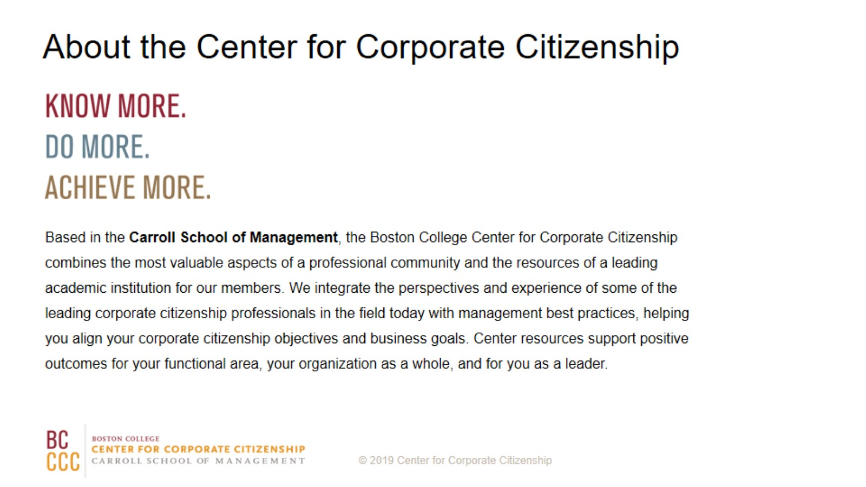
About the Center for Corporate Citizenship

