Slide 3
Companies find a positive correlation between volunteer participation and engagement scores
Notes:
Two-thirds of companies in the information technology industry measure the relationship between employee volunteer participation and employee engagement scores and all of those companies found a positive correlation.

Slide 4
Top social issues addressed through community involvement efforts
Notes:
More than 70% of information technology companies include STEM training and education among its top three social issues addressed through its community involvement efforts within its headquarters country. More than 40% include access to technology among the top five addressed, another issue that is core to their business.

Slide 5
Company reports having a foundation or is in the process of setting one up
Notes:
Companies within the information technology industry are less likely than companies in other industries to have a foundation or are in the process of setting one up. Overall, the percentage of companies with a foundation has declined from 53% in 2011 to one-half in 2015 and now down to 45% in the current study.

Slide 6
Community involvement contribution to business goals†
Notes:
Consistent with the total sample, all of the information technology companies report that community involvement contributes to enhanced reputation and improved ability to recruit employees. Information technology companies are more likely than the total sample to report that community involvement contributes to reducing employee turnover rate, 95% compared to 84%, respectively. Information technology firms are less likely, however, to report that community involvement contributes to the other business goals listed, with the exception of improved risk management.

Slide 7
Community involvement contribution to business goals by industry†
Notes:
Within each industry, corporate citizenship professionals were asked to identify their highest and lowest business goals. Business goals that received majority prioritization are maroon, while those that were prioritized in the middle are deep blue and by the fewest number of respondents are lightest blue. Companies across industries, including information technology, recognize the role of community involvement in enhancing reputation and employee recruitment.

Slide 8
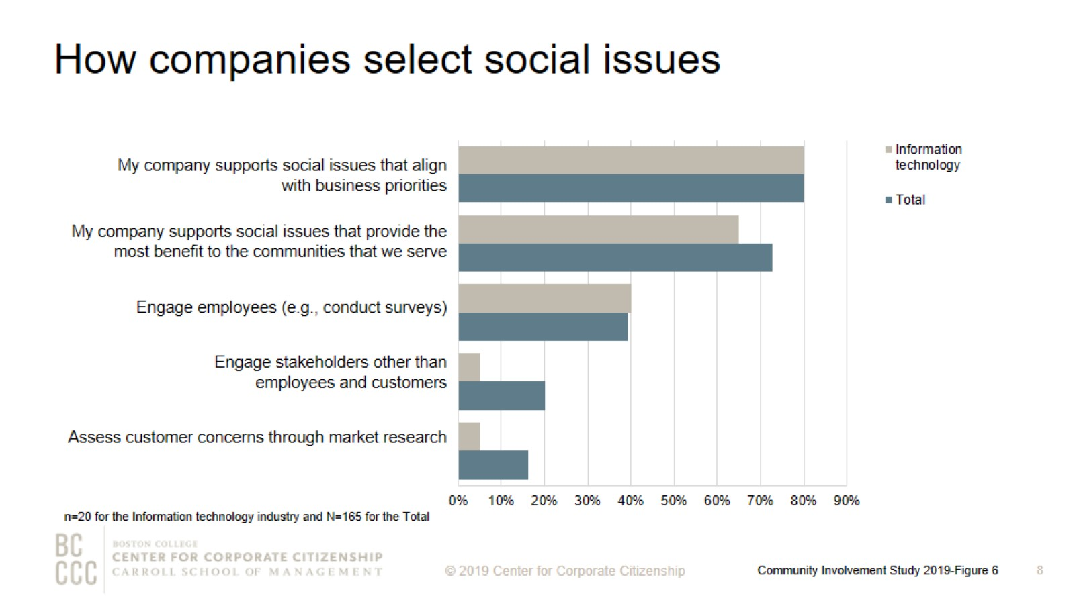
How companies select social issues
Notes:
As companies work to align community involvement efforts with their business strategies, many are reconsidering how they select the social issues to address. The most strategic companies select social issues that are important to their competitive operating environment or that they are uniquely positioned to address with their particularly differentiated capabilities and resources. Consistent with the total sample, the majority of information technology companies support social issues that align with business priorities and provide the most benefit to the communities they serve. Also consistent with the total sample, approximately 40% of information technology companies engage employees in the social issue selection process. A much smaller percentage—5% compared to 20% for the total sample—engage stakeholders other than employees and customers.

Slide 9
Top social issues addressed through community involvement efforts
Notes:
Nearly three-quarters of information technology companies include STEM training and education among the top three issues addressed through their community involvement programs in their headquarters country. A majority of information technology companies also include STEM training and education among the top three issues addressed globally. K-12 education is another top priority both inside and outside headquarters countries.

Slide 10
Percentage of companies that rank a social issue within their top 5
Notes:
The issues that companies select to address have some commonality within industries and reflect the unique capabilities and resources—from products and materials to expertise—that each company can deploy to address them. The heatmap illustrates the ways companies in different sectors are prioritizing issues. Information technology, in addition to materials/industrial and utility companies, are all likely to highly prioritize STEM education, which arms their future workforces with the skills needed to keep their operations running smoothly.

Slide 11
Community involvement professionals consistently rank employee engagement as a top benefit of volunteer programs
Notes:
Nearly 90% of information technology companies and firms across industries report that their company offers an employee volunteer program or are currently developing one. Employee engagement continues to be a strong motivator for companies that implement employee volunteer programs. More than 55% of information technology companies ranked improved employee engagement as the top benefit of volunteer programs. Information technology companies are almost twice as likely as the total sample to include strengthen employee networks among the top three benefits.

Slide 12
Volunteer program participation rates
Notes:
The majority of information technology companies report employee volunteering participation rates of 30% or less.

Slide 13
Ways that companies track employee volunteer participation
Notes:
More companies are now tracking their employee volunteering participation rates. The majority of information technology track participation in the employee volunteer program only.

Slide 14
Companies’ employee volunteer program offerings
Notes:
The majority of information technology companies provide paid time off for volunteering, and one-half offer nonprofit board placement and pro bono service. Nearly 40% of part-time employees are eligible to participate in paid time off for volunteering. All of the information technology companies that offer paid time off for volunteering provide remote employees based in the headquarters country and outside of it the opportunity to participate in the program.

Slide 15
Workplace giving programs
Notes:
In order to meet to a wide variety of employee interests, companies offer an assortment of options for employees to give. Three-quarters of information technology firms that have a workplace giving program offer disaster relief giving programs. More than 70% of information technology companies that offer workplace giving programs provide a match for at least one purpose. More than 85% of information technology companies offer a match for their gifts for any purpose programs.

Slide 16
Percent of companies offering giving programs, by employee type
Notes:
Information technology companies are twice as likely as the total sample to offer international employees the opportunity to participate in giving programs.

Slide 17
Giving directly from company
Notes:
How to read this chart
The orange line and right y-axis represent how the distributions accumulate to make 100% (the industry sub-sample). Companies represented by bars to the right of the red dot perform above the median.
Cash giving direct from the company is one of the three types of total giving to 501(c)(3) organizations or public schools, or the international equivalent of a 501(c)(3) organization. The majority of information technology companies gave $1,000,000 or less for the most recently ended fiscal year. Three of the four information technology companies that gave more than $5,000,000 have an annual revenue of at least $5 billion.

Slide 18
Giving directly through foundation
Notes:
How to read this chart
The orange line and right y-axis represent how the distributions accumulate to make 100% (the industry sub-sample). Companies represented by bars to the right of the red dot perform above the median.
Cash giving through the company’s foundation is one of the three types of total giving to 501(c)(3) organizations or public schools, or the international equivalent of a 501(c)(3) organization. One-half of information technology companies gave $5,000,000 or less for the most recently ended fiscal year, which is higher than cash giving. Consistent with the total sample, information technology companies are more likely to give higher amounts through their foundation than cash giving directly from the company. All of the information technology companies that gave through the foundation have an annual revenue of at least $1 billion. All four companies that gave more than $5,000,000 through the foundation have an annual revenue of $5 billion or more.

Slide 19
Noncash contributions*
Notes:
How to read this chart
The orange line and right y-axis represent how the distributions accumulate to make 100% (the industry sub-sample). Companies represented by bars to the right of the red dot perform above the median.
Noncash contributions assessed at fair market value (FMV) (e.g., merchandise, pro bono service, and supplies) is one of the three types of total giving to 501(c)(3) organizations or public schools, or the international equivalent of a 501(c)(3) organization. Many companies offer noncash contributions in addition to direct and foundation giving. The majority of information technology companies—five of the nine firms in this study—gave $500,000 or less in noncash contributions for the most recently ended fiscal year. The four companies that gave more than $1 billion have an annual revenue of at least $5 billion.

Slide 20
One-time gifts/grants - Typical amount
Notes:
How to read this chart
The orange line and right y-axis represent how the distributions accumulate to make 100% (the industry sub-sample). Companies represented by bars to the right of the red dot perform above the median.
Companies either give one-time donations or multi-year grants. Two-thirds of information technology companies are likely to offer a typical one-time gift or grant of $10,000 or less.

Slide 21
Annual operating budget for corporate giving
Notes:
Nearly all companies have a discrete operating budget (exclusive of the gifts and grants budget) allocated to managing giving efforts. Information technology companies are more likely to have a smaller budget than companies across industries. Eighty-five percent of information technology companies have an annual operating budget for corporate giving of less than $1,000,000, compared to 70% of the total sample.

Slide 22
Corporate giving to nonprofits based outside of headquarter countries
Notes:
Ninety percent of information technology companies give to nonprofits based outside of their headquarter countries, which is much higher than the total sample—47% of firms across industries give globally. All of the information technology companies operate globally.

Slide 23
Giving split between international and domestic nonprofits for global givers
Notes:
Companies are more likely to give internationally than in previous studies. Information technology firms and companies across industries give the same proportion on average to international and domestic nonprofits, 20% and 80%, respectively.

Slide 24
Using vendors to vet international nonprofit organizations
Notes:
Engaging in corporate giving internationally can be a complex task. While the benefits of global giving are many (expand markets, engage international employees, support suppliers), it can be difficult to navigate the regulations—and even cultural expectations—of different recipient countries. That’s why many companies are turning to vendors to help them manage global giving. In this study, nearly two-thirds of information technology companies use a vendor to vet international nonprofit organizations. One-third of information technology companies engage a vendor to actually execute the global giving, which is slightly higher than the total sample.

Slide 25
Measurement of community involvement programs
Notes:
Measurement level definitions
Inputs: resources needed to support a program (e.g., time spent, budget, materials, and marketing).
Outputs: units of goods or services that benefit a particular target audience (e.g., number of meals delivered or hours spent mentoring youth after school).
Outcomes: results, or effects on target audience; typically single-system and shorter term (e.g., improved child health, better school performance, or decrease in youth involved in gang-related activity).
Impact: long term, multi-system results (e.g., intergenerational gains in income equality).
The majority of information technology companies that measure at least one level of their employee volunteer programs (88%), employee giving (50%), and/or corporate giving (63%) report that they measure both inputs and outputs of their programs.

Slide 26
Method

Slide 27
Demographics

Slide 28
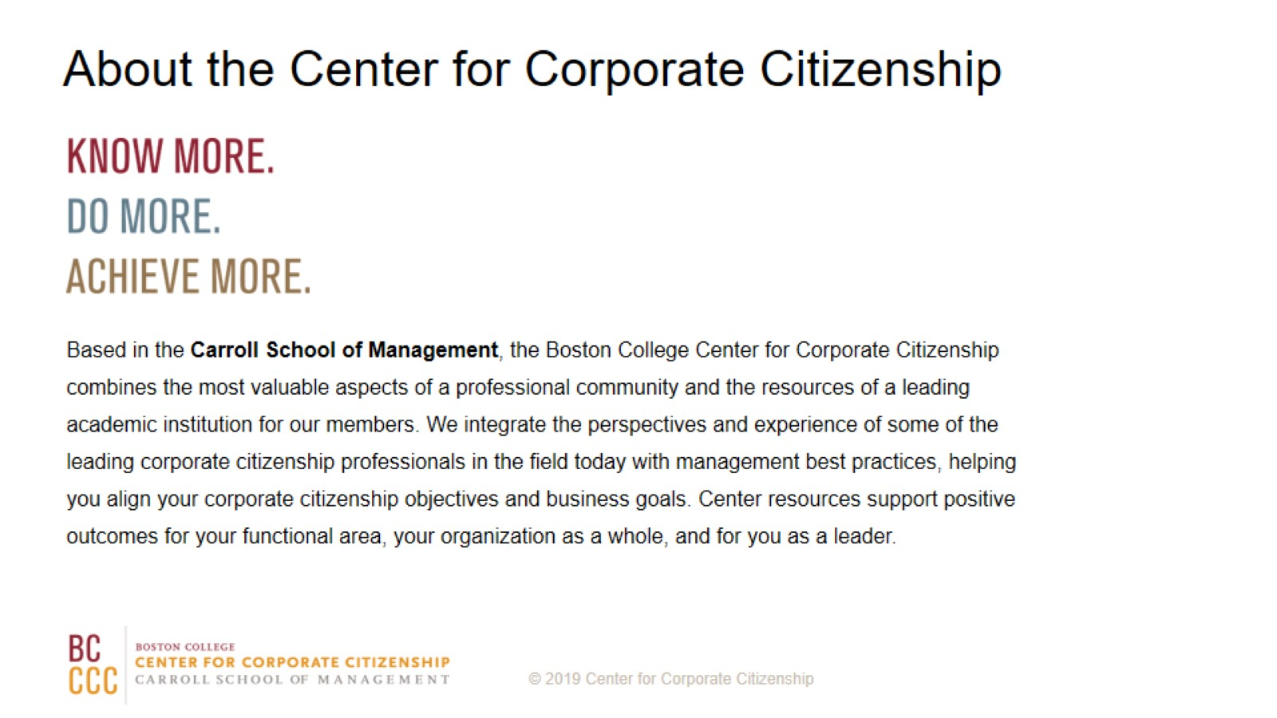
About the Center for Corporate Citizenship

