Slide 3
Top social issues addressed through community involvement efforts
Notes:
The majority of health care companies include health and wellness and STEM training and education among the top five issues addressed through their community involvement efforts both within their headquarters country and outside of it.

Slide 4
Company reports having a foundation or is in the process of setting one up
Notes:
Approximately 45% of health care companies and companies across industries have a foundation or are in the process of setting one up. Overall, the percentage of companies with a foundation has declined from 53% in 2011 to one-half in 2015 and now down to 45% in the current study.

Slide 5
Community involvement contribution to business goals†
Notes:
Consistent with the total sample, nearly all of the health care companies report that community involvement contributes to enhanced reputation and improved ability to recruit employees. At least 80% of health care companies report that community involvement contributes to improving access to new markets, reducing employee turnover, and attracting new investors.

Slide 6
Community involvement contribution to business goals by industry†
Notes:
Within each industry, corporate citizenship professionals were asked to identify their highest and lowest business goals. Business goals that received majority prioritization are maroon, while those that were prioritized in the middle are deep blue and by the fewest number of respondents are lightest blue. Companies across industries, including health care, recognize the role of community involvement in enhancing reputation and employee recruitment.

Slide 7
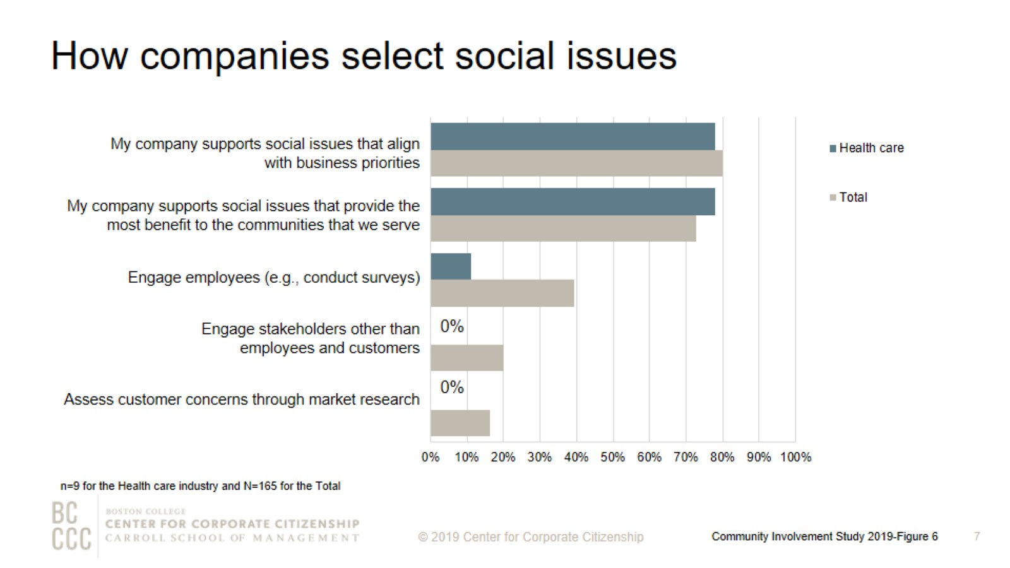
How companies select social issues
Notes:
As companies work to align community involvement efforts with their business strategies, many are reconsidering how they select the social issues to address. The most strategic companies select social issues that are important to their competitive operating environment or that they are uniquely positioned to address with their particularly differentiated capabilities and resources. Nearly 80% of health care companies support social issues that align with business priorities. Health care companies are less likely than firms across industries to engage employees in the selection of social issues.

Slide 8
Top social issues addressed through community involvement efforts
Notes:
Health care companies within their headquarters country and globally prioritize issues that are most core to their business, including health and wellness, STEM training and education, and non-communicable diseases.

Slide 9
Percentage of companies that rank a social issue within their top 5
Notes:
The issues that companies select to address have some commonality within industries and reflect the unique capabilities and resources—from products and materials to expertise—that each company can deploy to address them. The heatmap illustrates the ways companies in different sectors are prioritizing issues. Health care and insurance companies are most likely to prioritize health and wellness.

Slide 10
Percent of companies offering giving programs, by employee type
Notes:
Of the health care companies that offer a workplace giving program, nearly 90% provide a match for at least one type of program (e.g., giving campaign and disaster relief). One-half of health care companies offer part-time employees the opportunity to participate in their giving programs and 38% include retirees in their programs.

Slide 11
Giving directly from company
Notes:
How to read this chart
The orange line and right y-axis represent how the distributions accumulate to make 100% (the industry sub-sample). Companies represented by bars to the right of the red dot perform above the median.
Cash giving direct from the company is one of the three types of total giving to 501(c)(3) organizations or public schools, or the international equivalent of a 501(c)(3) organization. One-half of health care companies gave $5,000,000 or less for the most recently ended fiscal year. All of the companies that gave more than $5,000,000 have an annual revenue of at least $5 billion.

Slide 12
Noncash contributions
Notes:
How to read this chart
The orange line and right y-axis represent how the distributions accumulate to make 100% (the industry sub-sample). Companies represented by bars to the right of the red dot perform above the median.
Cash giving direct from the company is one of the three types of total giving to 501(c)(3) organizations or public schools, or the international equivalent of a 501(c)(3) organization. One-half of health care companies gave $5,000,000 or less for the most recently ended fiscal year. All of the companies that gave more than $5,000,000 have an annual revenue of at least $5 billion.

Slide 13
Corporate giving to nonprofits based outside of headquarter countries
Notes:
Two-thirds of health care companies give to nonprofits globally, which is higher than firms across industries (47%).

Slide 14
Method

Slide 15
Demographics

Slide 16
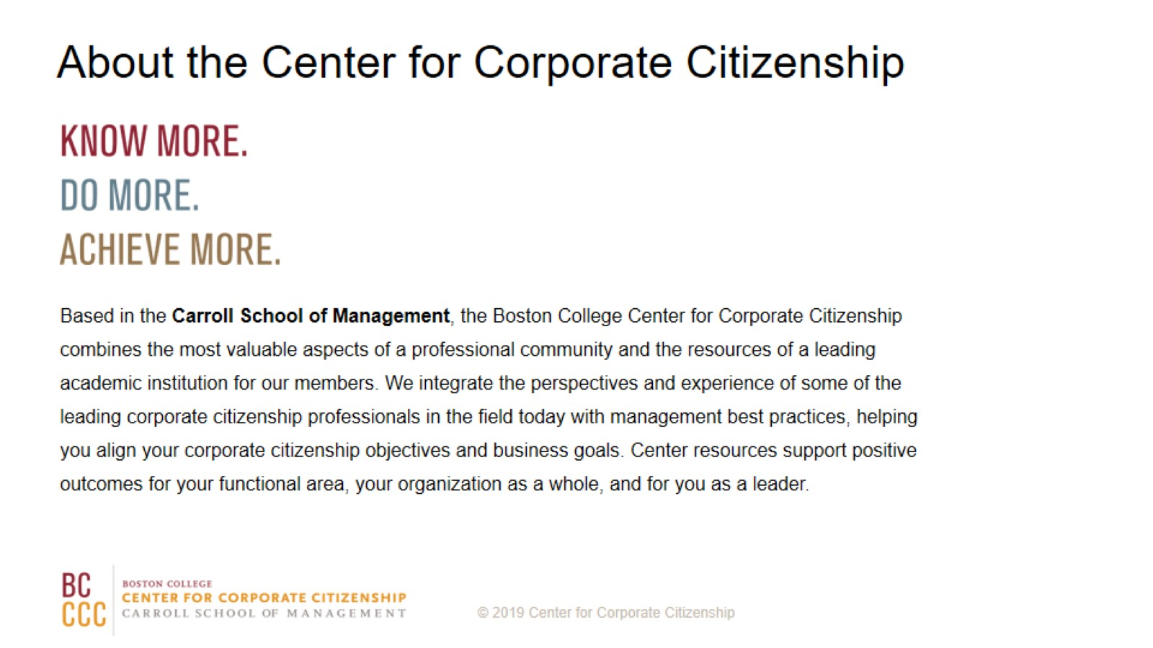
About the Center for Corporate Citizenship

