Slide 3
Top social issues addressed through community involvement efforts
Notes:
The majority of food/beverage/tobacco companies include health and wellness and youth programs among the top five issues addressed through their community involvement efforts. Across industries, companies were also likely to include health and wellness and youth programs among the top issues addressed, but they were most likely to report that STEM education and K-12 education are addressed through community involvement programs.

Slide 4
Company reports having a foundation or is in the process of setting one up
Notes:
One-half of food/beverage/tobacco companies have a foundation or are in the process of setting one up, which is higher than the total sample (45%). Overall, the percentage of companies with a foundation has declined from 53% in 2011 to one-half in 2015 and now down to 45% in the current study.

Slide 5
Community involvement contribution to business goals†
Notes:
Consistent with the total sample, all of the food/beverage/tobacco companies report that community involvement contributes to enhanced reputation and improved ability to recruit employees. All of the food/beverage/tobacco companies also report that community involvement contributes to attracting new customers and securing a sustainable supply chain. In comparison, 54% of companies across industries report that community involvement contributes to securing a sustainable supply chain.

Slide 6
Community involvement contribution to business goals by industry†
Notes:
Within each industry, corporate citizenship professionals were asked to identify their highest and lowest business goals. Business goals that received majority prioritization are maroon, while those that were prioritized in the middle are deep blue and by the fewest number of respondents are lightest blue. Companies across industries, including food/beverage/tobacco, recognize the role of community involvement in enhancing reputation and employee recruitment.

Slide 7
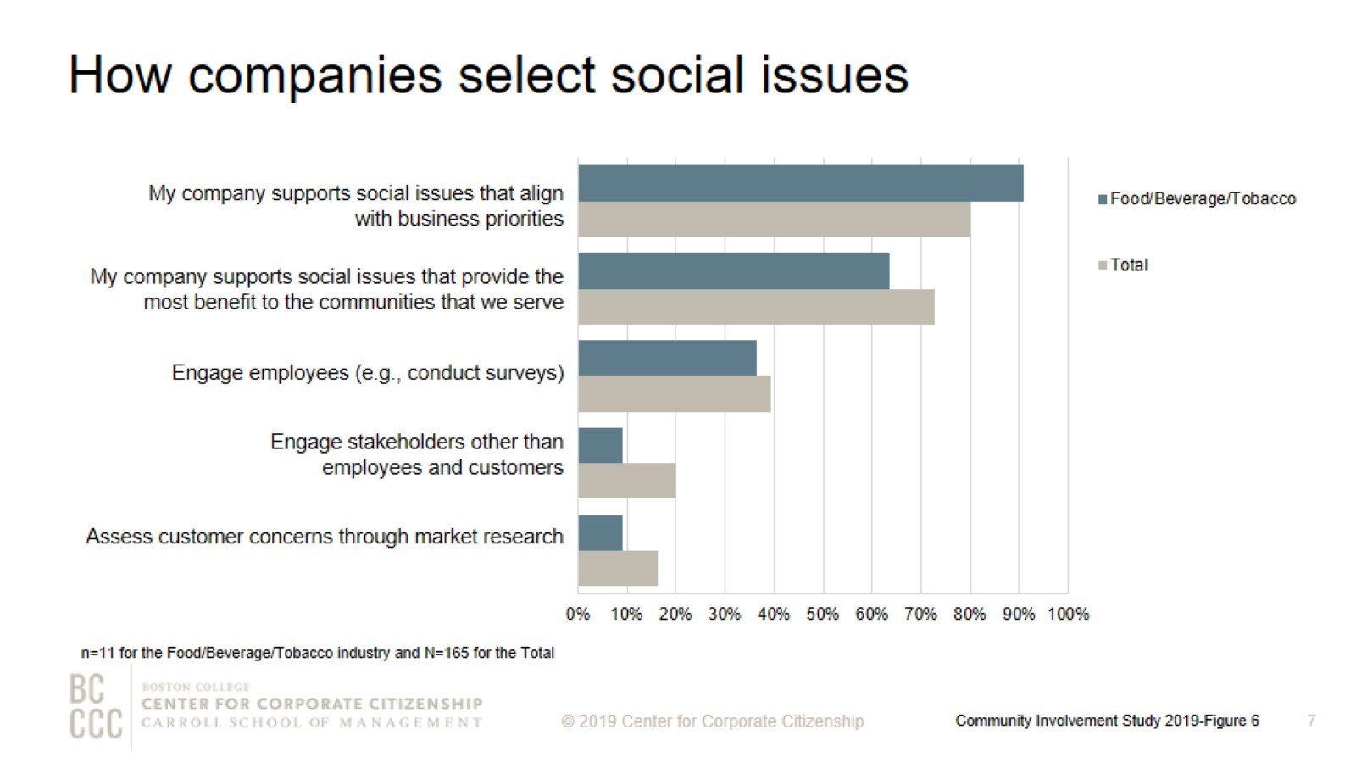
How companies select social issues
Notes:
As companies work to align community involvement efforts with their business strategies, many are reconsidering how they select the social issues to address. The most strategic companies select social issues that are important to their competitive operating environment or that they are uniquely positioned to address with their particularly differentiated capabilities and resources. More than 90% of the food/beverage/tobacco companies support social issues that align with business priorities. Food/beverage/tobacco companies are less likely than firms across industries to engage stakeholders other than employees and customers, 9% versus 20%, respectively.

Slide 8
Top social issues addressed through community involvement efforts
Notes:
Food/beverage/tobacco companies are more than twice as likely than the total sample to include environmental sustainability among their top three issues addressed through community involvement efforts.

Slide 9
Percentage of companies that rank a social issue within their top 5
Notes:
The issues that companies select to address have some commonality within industries and reflect the unique capabilities and resources—from products and materials to expertise—that each company can deploy to address them. The heatmap illustrates the ways companies in different sectors are prioritizing issues. Food/beverage/tobacco companies, along with health care and insurance companies, are most likely to prioritize health and wellness.

Slide 10
Giving directly from company
Notes:
How to read this chart
The orange line and right y-axis represent how the distributions accumulate to make 100% (the industry sub-sample). Companies represented by bars to the right of the red dot perform above the median.
Cash giving direct from the company is one of the three types of total giving to 501(c)(3) organizations or public schools, or the international equivalent of a 501(c)(3) organization. More than 70% of food/beverage/tobacco companies gave $5,000,000 or less for the most recently ended fiscal year.

Slide 11
Noncash contributions
Notes:
How to read this chart
The orange line and right y-axis represent how the distributions accumulate to make 100% (the industry sub-sample). Companies represented by bars to the right of the red dot perform above the median.
Noncash contributions assessed at fair market value (FMV) (e.g., merchandise, pro bono service, and supplies) is one of the three types of total giving to 501(c)(3) organizations or public schools, or the international equivalent of a 501(c)(3) organization. Many companies offer noncash contributions in addition to direct and foundation giving. The majority of food/beverage/tobacco companies gave less than $2,500,000 in noncash contributions for the most recently ended fiscal year. Four of the five companies that gave more than $2,500,000 in noncash contributions have an annual revenue of at least $5 billion.

Slide 12
Corporate giving to nonprofits based outside of headquarter countries
Notes:
More than 35% of food/beverage/tobacco companies give to nonprofits globally, which is lower than firms across industries (47%).

Slide 13
Method

Slide 14
Demographics

Slide 15
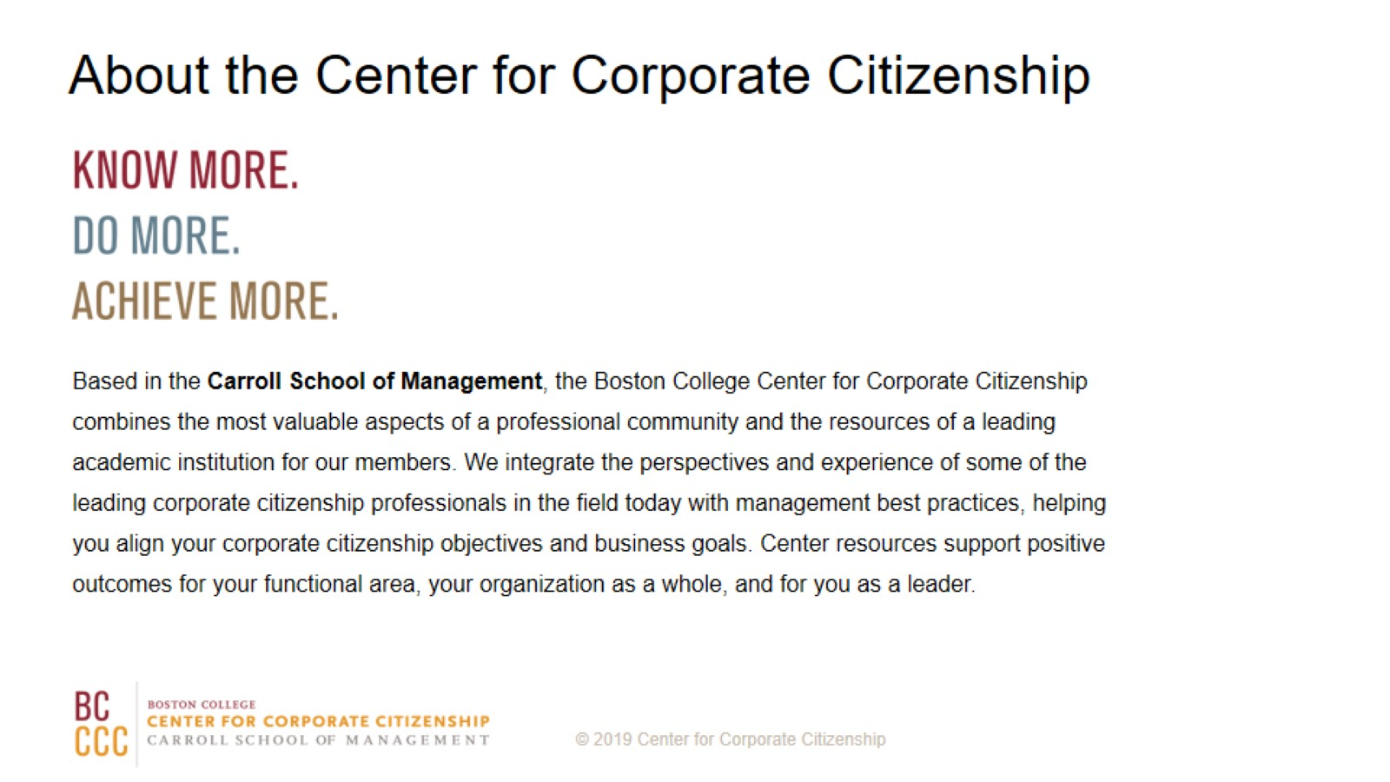
About the Center for Corporate Citizenship

