Slide 3
Companies find a positive correlation between volunteer participation and engagement scores
Notes:
All of the financial companies that measure the relationship between employee volunteer participation and employee engagement scores found a positive correlation.

Slide 4
Top social issues addressed through community involvement efforts
Notes:
Consistent with firms in other industries, financial companies are most likely to prioritize social issues that are core to their business – financial literacy and community economic development.

Slide 5
Company reports having a foundation or is in the process of setting one up
Notes:
Forty percent of financial companies have a foundation that administers some or all of their corporate giving or are in the process of setting one up. This is lower than the total sample, where 45% of companies have a foundation in place or are currently setting one up. Overall, the percentage of companies with a foundation has declined from 53% in 2011 to one-half in 2015 and now down to 45% in the current study.

Slide 6
Community involvement contribution to business goals†
Notes:
At least 85% or more of financial companies and firms across industries report that community involvement contributes to enhanced reputation, improved ability to recruit employees, and attraction of new customers.

Slide 7
Community involvement contribution to business goals by industry†
Notes:
Within each industry, corporate citizenship professionals were asked to identify their highest and lowest business goals. Business goals that received majority prioritization are maroon, while those that were prioritized in the middle are deep blue and by the fewest number of respondents are lightest blue. Companies across industries, including financials, recognize the role of community involvement in enhancing reputation, attracting new customers, and employee recruitment and retention.

Slide 8
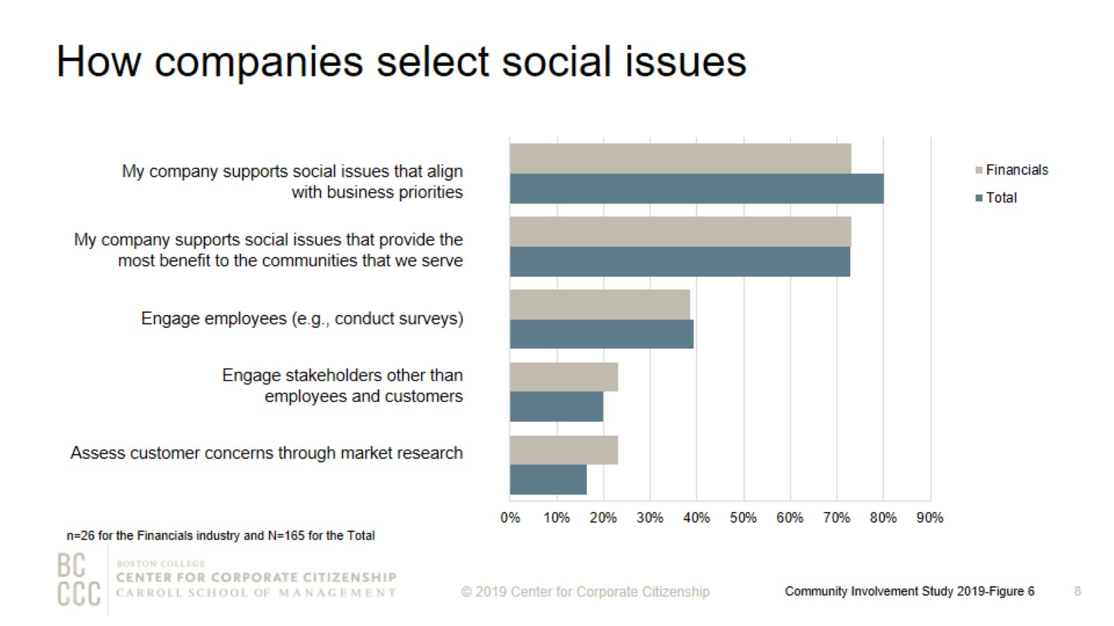
How companies select social issues
Notes:
As companies work to align community involvement efforts with their business strategies, many are reconsidering how they select the social issues to address. The most strategic companies select social issues that are important to their competitive operating environment or that they are uniquely positioned to address with their particularly differentiated capabilities and resources. In this study, 73% of financial companies report that they support social issues that align with business priorities.

Slide 9
Top social issues addressed through community involvement efforts
Notes:
Financial companies and firms across industries both prioritize K-12 education and youth programs.

Slide 10
Percentage of companies that rank a social issue within their top 5
Notes:
The issues that companies select to address have some commonality within industries and reflect the unique capabilities and resources—from products and materials to expertise—that each company can deploy to address them. The heatmap illustrates the ways companies in different sectors are prioritizing issues. Financial companies focus their efforts on affordable housing and homelessness and financial literacy, issues that can be addressed by the unique resources and skills these organizations can provide. Information technology, materials/industrial, and utility companies are all likely to highly prioritize STEM education, which arms their future workforces with the skills needed to keep their operations running smoothly. Health care and insurance companies are most likely to prioritize health and wellness, a social issue with obvious connection to their purpose.

Slide 11
Community involvement professionals consistently rank employee engagement as a top benefit of volunteer programs
Notes:
More than 90% of financial companies report that their firm offers an employee volunteer program or are currently developing one. Employee engagement continues to be the strongest motivator for companies that implement employee volunteer programs. More than 80% of financial companies and companies across industries ranked engaging employees as a top benefit of volunteer programs.

Slide 12
Volunteer program participation rates
Notes:
More than one-third of financial companies report employee volunteering participation rates between 20% and 30%.

Slide 13
Ways that companies track employee volunteer participation
Notes:
More companies are now tracking their employee volunteering participation rates. Almost all company respondents, including within the financials industry, report tracking employee volunteer participation in either the corporate program or outside of it.

Slide 14
Annual operating budget for employee volunteer programs for prior fiscal year
Notes:
As employee volunteer programs expand and serve business needs more directly, a majority of companies have a dedicated budget just for employee volunteer programs. One-half of financial companies are spending at least $100,000 per year on volunteer programs, compared to 53% of the total sample.

Slide 15
Companies’ employee volunteer program offerings
Notes:
The majority of financial companies offer paid time for volunteering and nonprofit board placement programs, and companywide day(s) of service. Financial companies typically offer part-time employees the opportunity to participate in their volunteer programs, particularly micro-volunteering, pro bono service, and companywide day(s) of service.

Slide 16
Remote employees’ eligibility for volunteer program offerings
Notes:
The majority of financial companies offer remote employees based in the headquarters region the opportunity to participate in paid time off for volunteering, companywide day(s) of service, and pro bono service.

Slide 17
Workplace giving programs
Notes:
In order to meet to a wide variety of employee interests, companies offer an assortment of options for employees to give. More than three-quarters of financial companies that offer a workplace giving program have a dedicated campaign for workplace giving. The majority of financial companies also offer a disaster relief giving program. Nearly 70% of financial companies that offer workplace giving programs provide a match for at least one purpose. Of the companies that offer gifts for any purpose, all of them provide a match.

Slide 18
Percent of companies offering giving programs, by employee type
Notes:
Financial companies are less likely than firms across industries to offer employees outside the headquarters country the opportunity to participate in giving programs, one-quarter compared to one-third of the total sample.

Slide 19
Giving directly from company
Notes:
How to read this chart
The orange line and right y-axis represent how the distributions accumulate to make 100% (the industry sub-sample). Companies represented by bars to the right of the red dot perform above the median.
Cash giving direct from the company is one of the three types of total giving to 501(c)(3) organizations or public schools, or the international equivalent of a 501(c)(3) organization. The majority of financial companies gave $2,500,000 or less for the most recently ended fiscal year. All of the companies that gave more than $50,000,000 have an annual revenue of at least $5 billion.

Slide 20
Giving directly through foundation
Notes:
How to read this chart
The orange line and right y-axis represent how the distributions accumulate to make 100% (the industry sub-sample). Companies represented by bars to the right of the red dot perform above the median.
Cash giving through the company’s foundation is one of the three types of total giving to 501(c)(3) organizations or public schools, or the international equivalent of a 501(c)(3) organization. The majority of financial companies gave $10,000,000 or less for the most recently ended fiscal year, which is higher than cash giving. Consistent with the total sample, financial companies are more likely to give higher amounts through their foundation than cash giving directly from the company. All of the companies that gave more than $10,000,000 through the foundation have an annual revenue of at least $5 billion.

Slide 21
Noncash contributions*
Notes:
How to read this chart
The orange line and right y-axis represent how the distributions accumulate to make 100% (the industry sub-sample). Companies represented by bars to the right of the red dot perform above the median.
Noncash contributions assessed at fair market value (FMV) (e.g., merchandise, pro bono service, and supplies) is one of the three types of total giving to 501(c)(3) organizations or public schools, or the international equivalent of a 501(c)(3) organization. Many companies offer noncash contributions in addition to direct and foundation giving. The majority of financial companies—five of the eight firms in this study—gave $100,000 or less in noncash contributions for the most recently ended fiscal year.

Slide 22
One-time gifts/grants - Typical amount
Notes:
How to read this chart
The orange line and right y-axis represent how the distributions accumulate to make 100% (the industry sub-sample). Companies represented by bars to the right of the red dot perform above the median.
Companies either give one-time donations or multi-year grants. Fifty-five percent are likely to offer a typical one-time gift or grant of $10,000 or less.

Slide 23
Multi-year gifts/grants - Minimum amount
Notes:
How to read this chart
The orange line and right y-axis represent how the distributions accumulate to make 100% (the industry sub-sample). Companies represented by bars to the right of the red dot perform above the median.
The minimum sized multi-year gift/grant offered by three quarters of financial companies is $50,000 or less.

Slide 24
Multi-year gifts/grants - Typical amount
Notes:
How to read this chart
The orange line and right y-axis represent how the distributions accumulate to make 100% (the industry sub-sample). Companies represented by bars to the right of the red dot perform above the median.
More than 60% of financial companies donate $100,000 or less as a typical multi-year grant.

Slide 25
Multi-year gifts/grants - Maximum amount
Notes:
How to read this chart
The orange line and right y-axis represent how the distributions accumulate to make 100% (the industry sub-sample). Companies represented by bars to the right of the red dot perform above the median.
The maximum sized multi-year gift/grant offered by the majority of financial companies is $500,000 or less.

Slide 26
Annual operating budget for corporate giving
Notes:
Nearly all companies have a discrete operating budget (exclusive of the gifts and grants budget) allocated to managing giving efforts. Approximately 30% of financial companies and firms across industries have an annual operating budget for corporate giving operations of at least $1 million exclusive of gifts.

Slide 27
Structure of corporate foundations
Notes:
Consistent with the total sample, the most common type of foundation is primarily pass-through for financial companies, which means at least 75% of the foundation’s gifts/grants budget is provided annually by the company.

Slide 28
Corporate giving to nonprofits based outside of headquarter countries
Notes:
Only 19% of financial companies give to nonprofits based outside of their headquarter countries, compared to nearly 50% of firms across industries that give globally. Financial companies are much more likely to have domestic operations only compared to the total sample.

Slide 29
Measurement of community involvement programs
Notes:
Measurement level definitions
Inputs: resources needed to support a program (e.g., time spent, budget, materials, and marketing).
Outputs: units of goods or services that benefit a particular target audience (e.g., number of meals delivered or hours spent mentoring youth after school).
Outcomes: results, or effects on target audience; typically single-system and shorter term (e.g., improved child health, better school performance, or decrease in youth involved in gang-related activity).
Impact: long term, multi-system results (e.g., intergenerational gains in income equality).
The majority of financial companies that measure at least one level of their employee volunteer programs (73%), employee giving (58%), and/or corporate giving (80%) report that they measure both inputs and outputs of their programs.

Slide 30
Method

Slide 31
Demographics

Slide 32
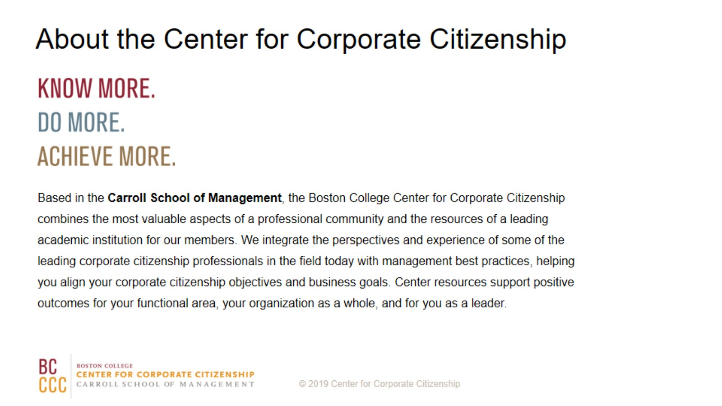
About the Center for Corporate Citizenship

