Slide 3
Top social issues addressed through community involvement efforts
Notes:
The majority of energy companies include STEM training and K-12 education among the top three issues addressed through their community involvement efforts. This is consistent with the total sample, as companies across industries are also most likely to include STEM training and education among the top three.

Slide 4
Company reports having a foundation or is in the process of setting one up
Notes:
More than 35% of energy companies have a foundation or are in the process of setting one up, which is lower than the total sample (45%). Overall, the percentage of companies with a foundation has declined from 53% in 2011 to one-half in 2015 and now down to 45% in the current study.

Slide 5
Community involvement contribution to business goals†
Notes:
Consistent with the total sample, nearly all of the energy companies report that community involvement contributes to enhanced reputation and improved ability to recruit employees. Energy companies are more likely than companies across industries to report that community involvement contributes to achieving access to new markets and improving risk management.

Slide 6
Community involvement contribution to business goals by industry†
Notes:
Within each industry, corporate citizenship professionals were asked to identify their highest and lowest business goals. Business goals that received majority prioritization are maroon, while those that were prioritized in the middle are deep blue and by the fewest number of respondents are lightest blue. Companies across industries, including energy, recognize the role of community involvement in enhancing reputation and employee recruitment.

Slide 7
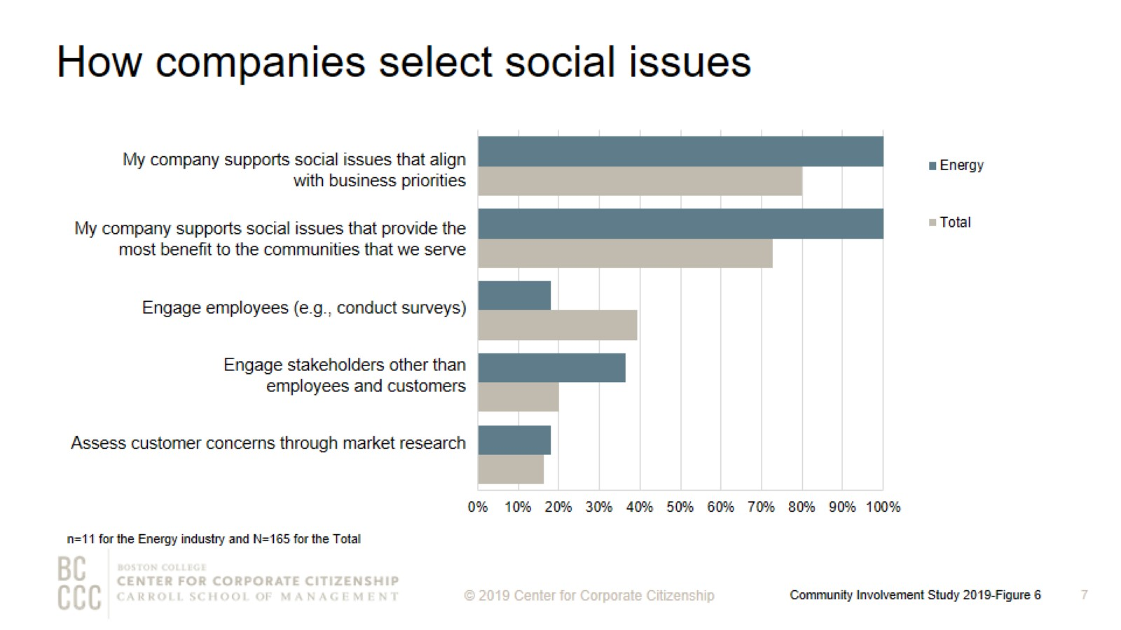
How companies select social issues
Notes:
As companies work to align community involvement efforts with their business strategies, many are reconsidering how they select the social issues to address. The most strategic companies select social issues that are important to their competitive operating environment or that they are uniquely positioned to address with their particularly differentiated capabilities and resources. All of the energy companies in this sample support social issues that align with business priorities and provide the most benefit to the communities that they serve.

Slide 8
Top social issues addressed through community involvement efforts
Notes:
Consistent with the total sample, energy companies are most likely to include STEM training and education, K-12 education, and health and wellness among the top three issues addressed through its community involvement programs.

Slide 9
Percentage of companies that rank a social issue within their top 5
Notes:
The issues that companies select to address have some commonality within industries and reflect the unique capabilities and resources—from products and materials to expertise—that each company can deploy to address them. The heatmap illustrates the ways companies in different sectors are prioritizing issues. Energy companies, in addition to information technology, materials/industrial, and utility companies, are all likely to highly prioritize STEM education, which arms their future workforces with the skills needed to keep their operations running smoothly.

Slide 10
Community involvement professionals consistently rank employee engagement as a top benefit of volunteer programs
Notes:
More than 80% of energy companies report that their company offers an employee volunteer program, which is slightly lower than the total sample where nearly 90% have an employee volunteer program or are in the process of developing one. Employee engagement continues to be a strong motivator for companies that implement employee volunteer programs. Nearly 90% of energy companies ranked improved employee engagement as one of the top three benefits of volunteer programs. Reputation is another strong motivator for energy companies and for firms across industries. One-half of energy companies reported that establishing a positive brand within operating communities is the top benefit of their volunteer program.

Slide 11
Ways that companies track employee volunteer participation
Notes:
More companies are now tracking their employee volunteering participation rates. Six of the eight energy companies—75%—track participation both in the employee volunteer program and outside of it. This is higher than the 54% of firms across industries that track any form of volunteering.

Slide 12
Workplace giving programs
Notes:
In order to meet to a wide variety of employee interests, companies offer an assortment of options for employees to give. All of the energy companies that have a workplace giving program offer a disaster relief program. The majority of energy companies also offer a giving campaign and gifts for any purpose. More than 60% of energy companies provide a match for their giving campaign. Seventy percent of energy companies that offer workplace giving programs provide a match for at least one purpose.

Slide 13
Percent of companies offering giving programs, by employee type
Notes:
Energy companies are 50% more likely than the total sample to offer board members the opportunity to participate in giving programs.

Slide 14
Giving directly from company
Notes:
How to read this chart
The orange line and right y-axis represent how the distributions accumulate to make 100% (the industry sub-sample). Companies represented by bars to the right of the red dot perform above the median.
Cash giving direct from the company is one of the three types of total giving to 501(c)(3) organizations or public schools, or the international equivalent of a 501(c)(3) organization. The majority of energy companies gave $5,000,000 or less for the most recently ended fiscal year. All of the energy companies that gave more than $5,000,000 have an annual revenue of at least $5 billion.

Slide 15
One-time gifts/grants - Typical amount
Notes:
How to read this chart
The orange line and right y-axis represent how the distributions accumulate to make 100% (the industry sub-sample). Companies represented by bars to the right of the red dot perform above the median.
Companies either give one-time donations or multi-year grants. More than 55% of energy companies offer a typical one-time gift or grant of $25,000 or less.

Slide 16
Annual operating budget for corporate giving
Notes:
Nearly all companies have a discrete operating budget (exclusive of the gifts and grants budget) allocated to managing giving efforts. Seven of the eight energy companies have a corporate giving operating budget of less than $500,000.

Slide 17
Corporate giving to nonprofits based outside of headquarter countries
Notes:
Fifty-five percent of energy companies give to nonprofits globally, compared to 47% of firms across industries.

Slide 18
Method

Slide 19
Demographics

Slide 20
About the Center for Corporate Citizenship

